Slide 1




PRIDE & quantms
Reproducible quantitative MS-based proteomics with PRIDE
Yasset Perez-Riverol PhD
Team Coordinator, PRIDE, EMBL-EBI
@ypriverol

Slide 2
Outline
The PRoteomics IDEntification Database (PRIDE)
The Sample to Metadata relationship format (SDRF)
quantms: A cloud-based for quantitative proteomics analysis
DDA identification workflow
Quantitative analysis TMT and LFQ
Quality control using pmultiqc
Downstream analysis with Msstats

Slide 3
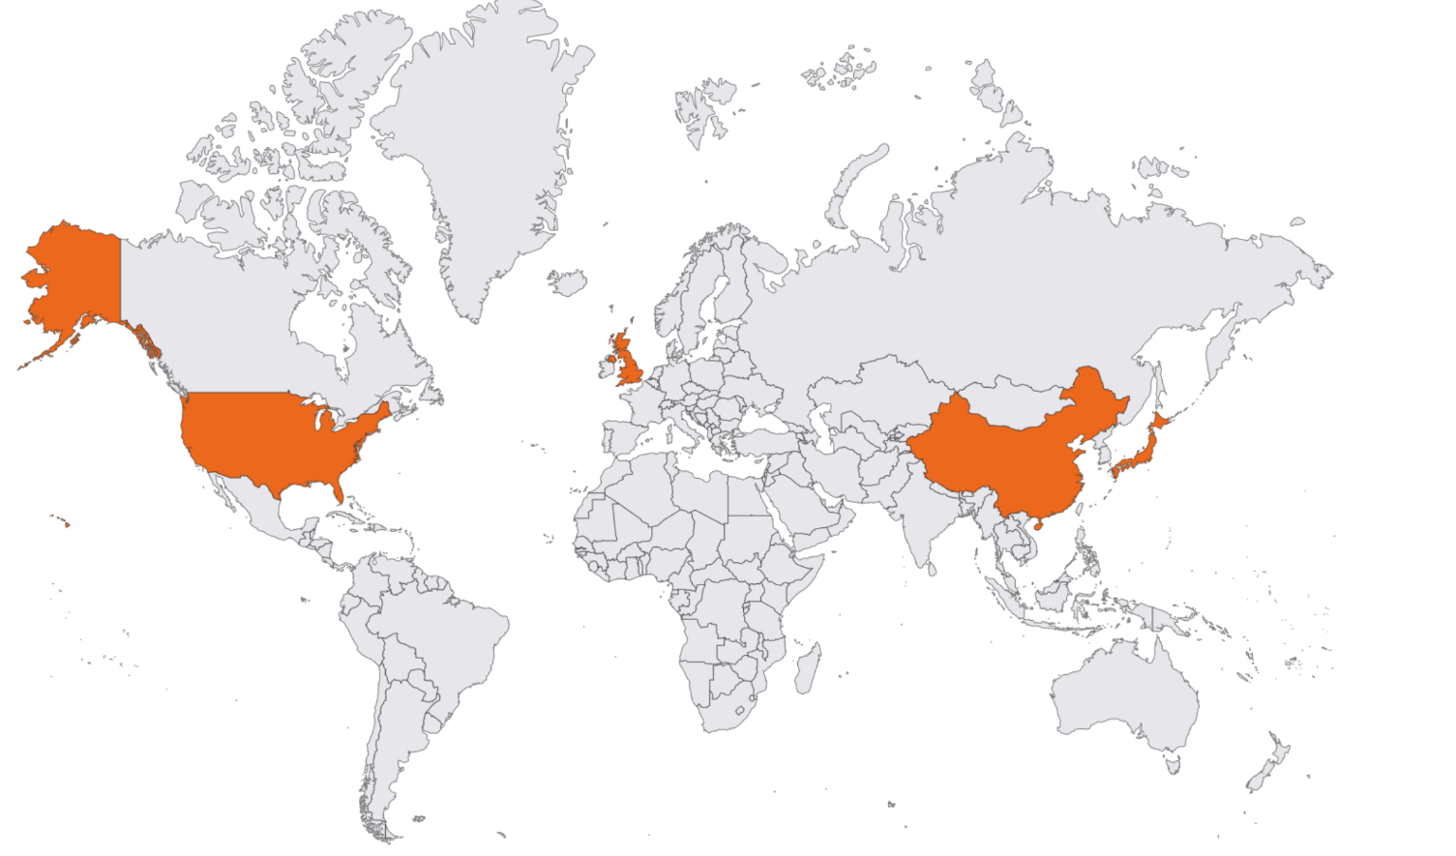











ProteomeXchange Consortium
Implements standard data submission and data dissemination practises between the main proteomics repositories
Raw data
ID &
Quant
Meta data
Mandatory data deposition
http://www.proteomexchange.org

Slide 4
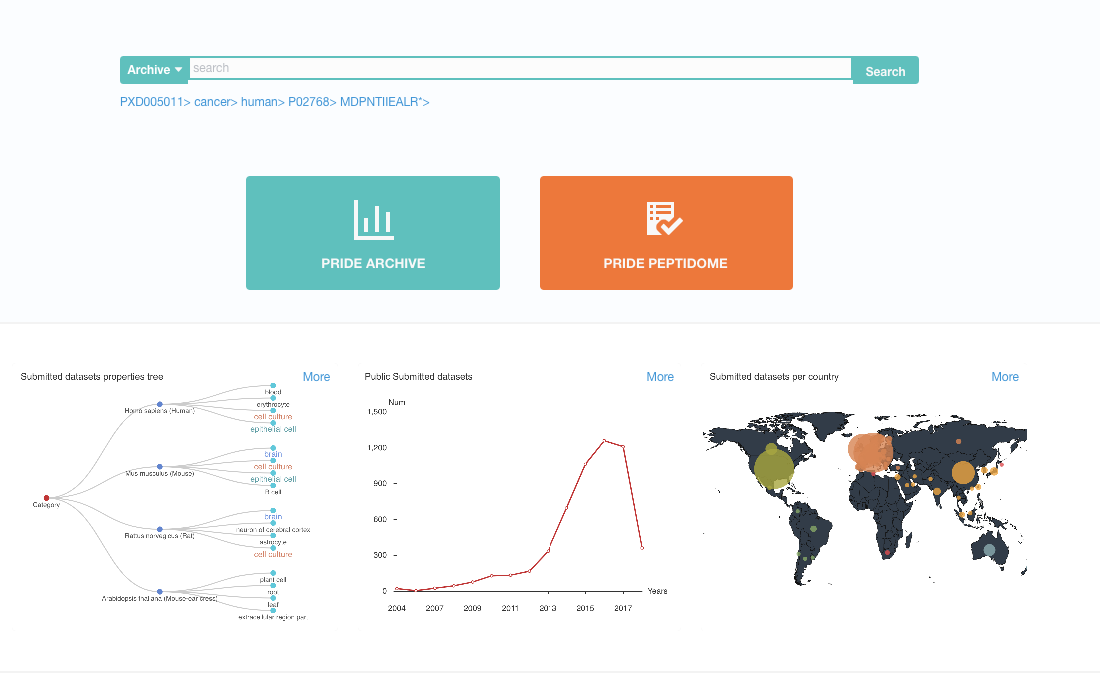
PRIDE Resources (Mission)
Archive all types of proteomics mass spectrometry data for the purpose of supporting reproducible research. Provide quality control metrics and visualization components to enable the assessment and re-use of these data by other researchers.
To disseminate mass spectrometry based proteomics data to other bioinformatics resources including UniProt, Ensembl and Expression Atlas.
http://www.ebi.ac.uk/pride/archive/
Perez-Riverol et al., NAR, 2020

Slide 5
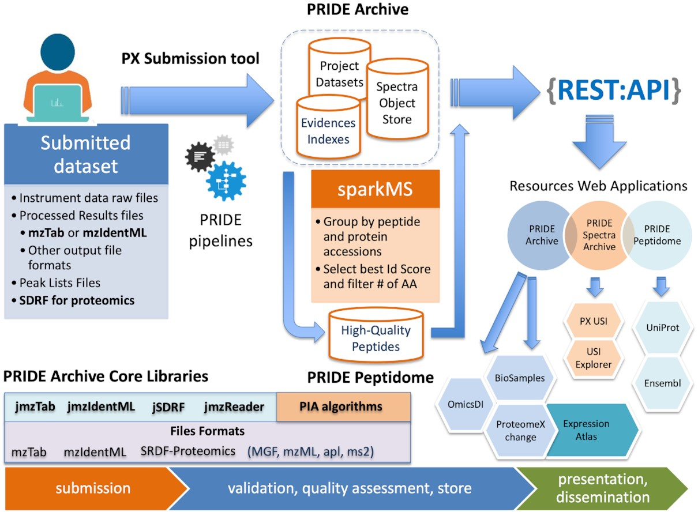
Yasset Perez-Riverol, et. al. Nucleic Acids Research, Volume 50, Issue D1, 7 January 2022, Pages D543–D552, https://doi.org/10.1093/nar/gkab1038

Slide 6
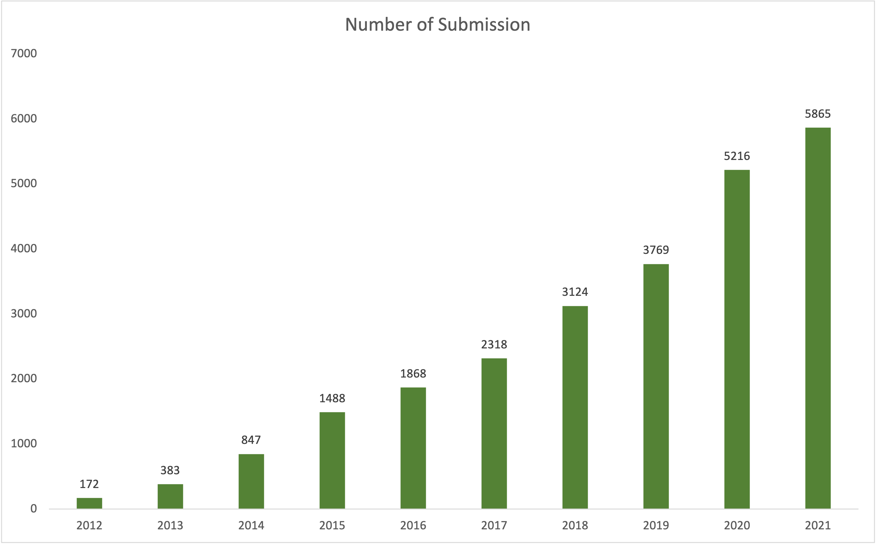
PRIDE Dataset number and volume
27697 datasets
~12%
An average of ~490 submitted datasets/month during 2021 -> ~5,800 datasets in 2021. >83% of all ProteomeXchange datasets

Slide 7
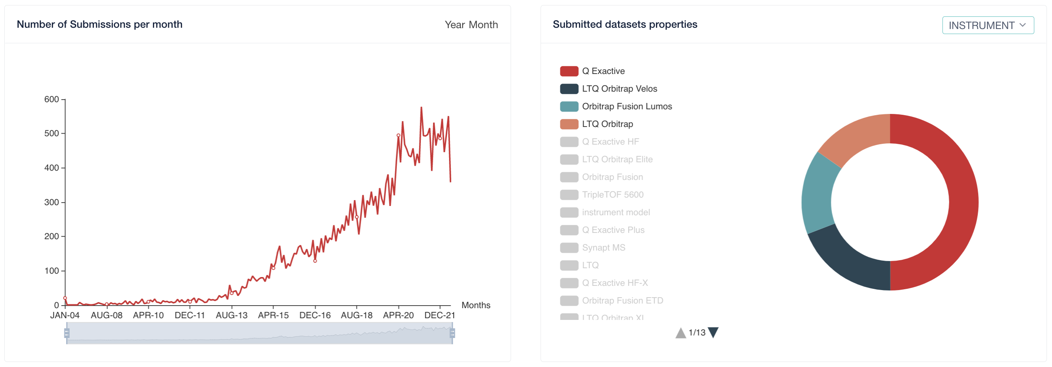
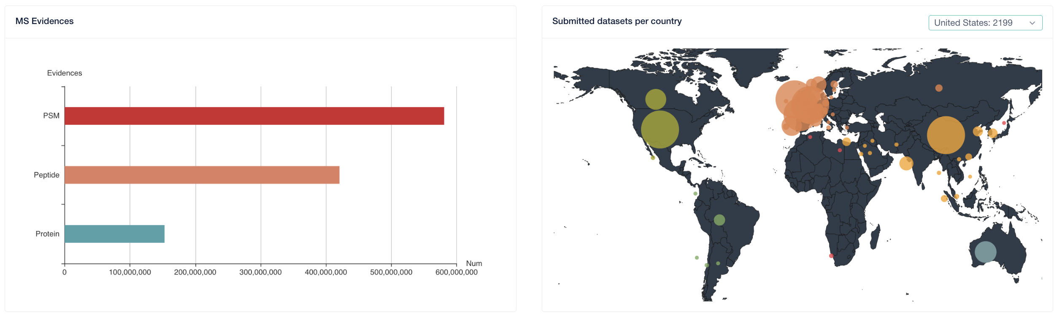
PRIDE database statistics

Slide 8
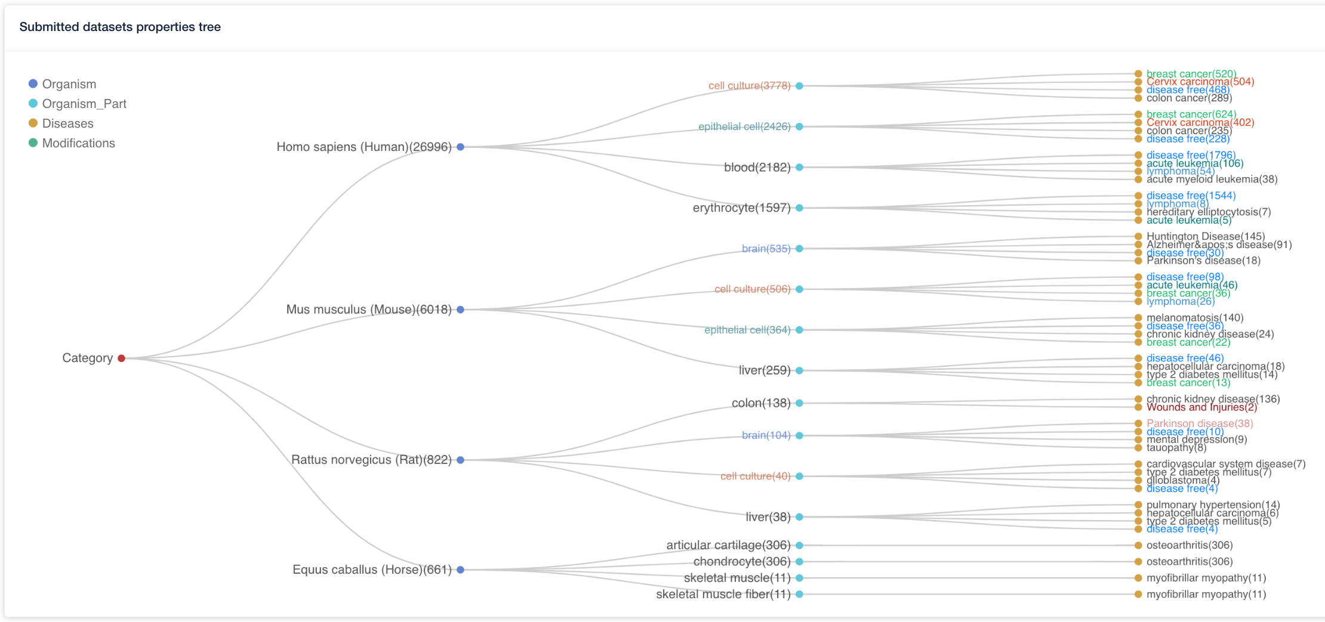
PRIDE database statistics

Slide 9
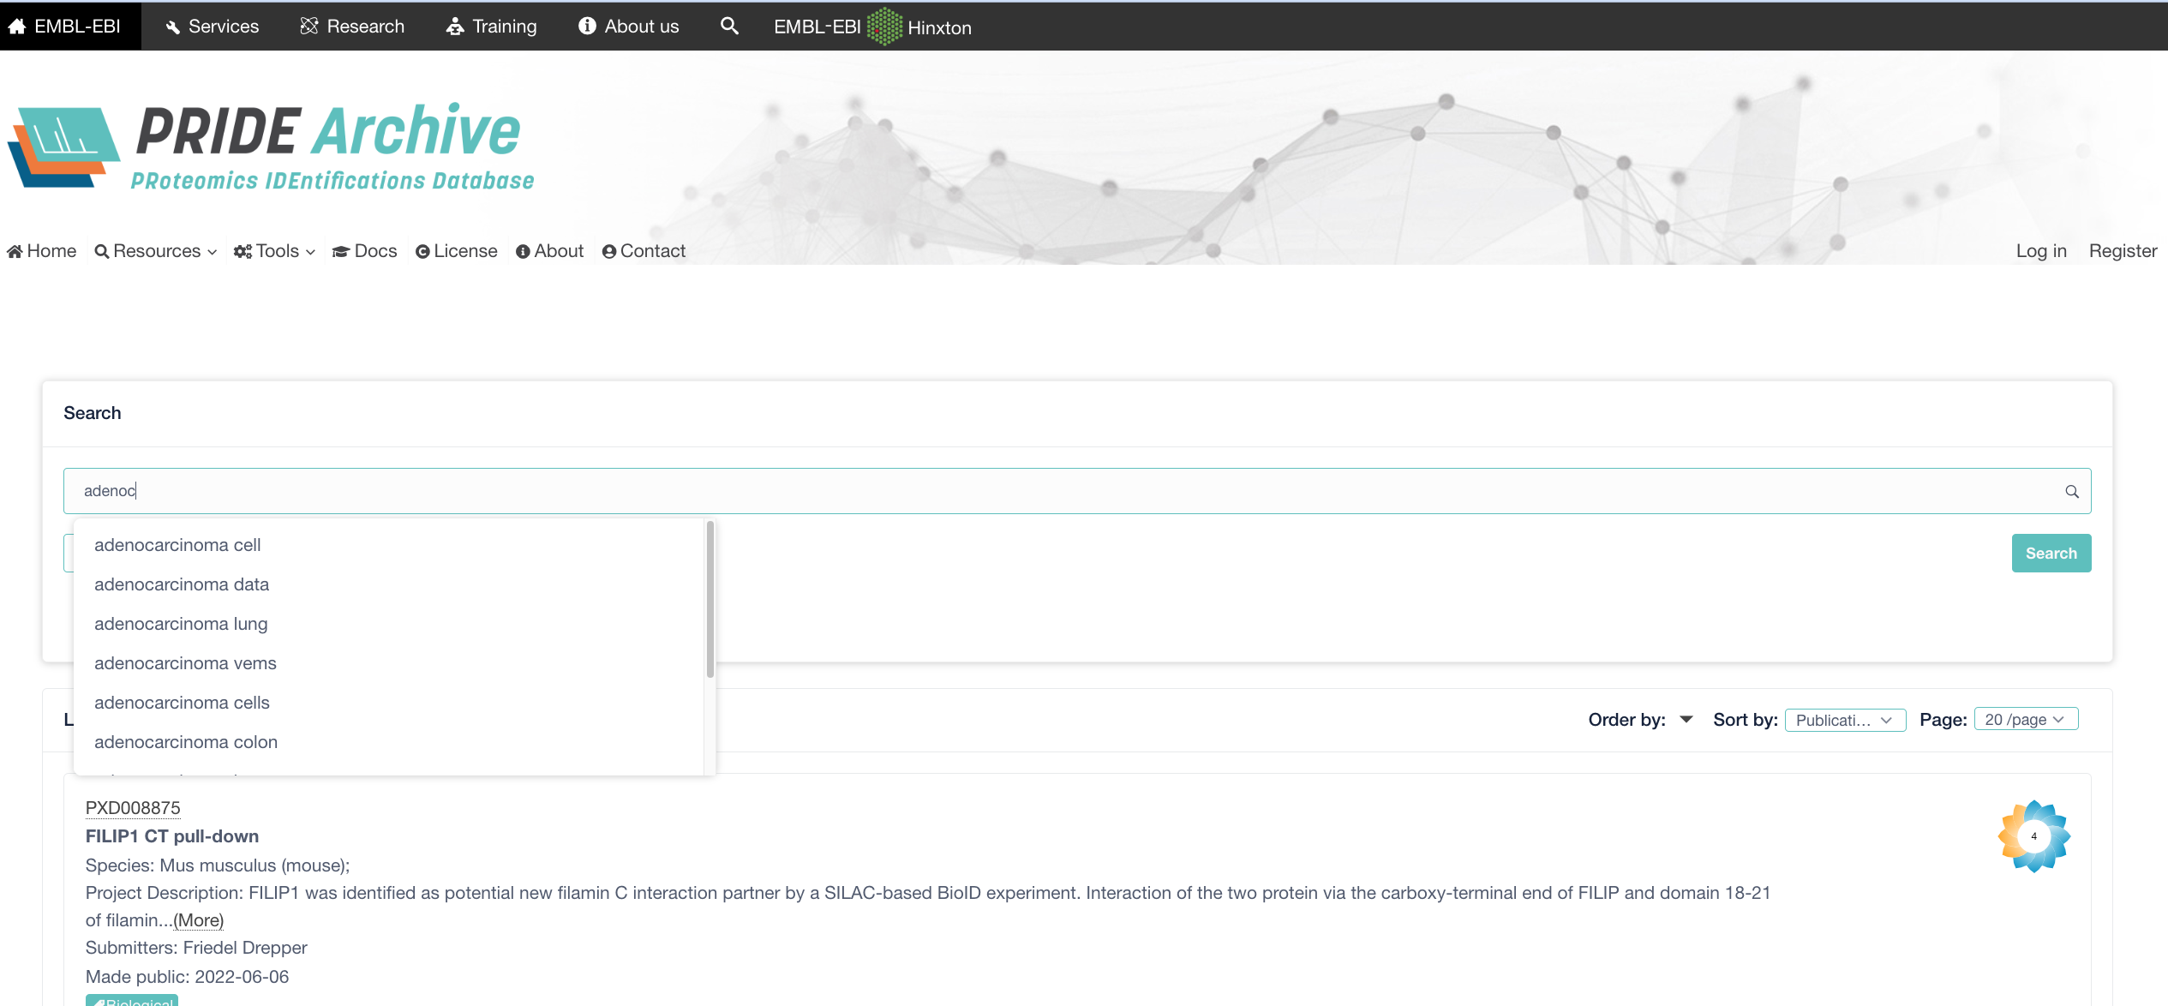
Searching for PRIDE datasets
https://www.ebi.ac.uk/pride/archive

Slide 10
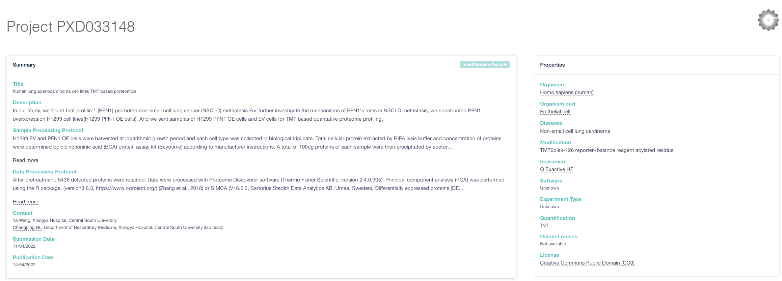
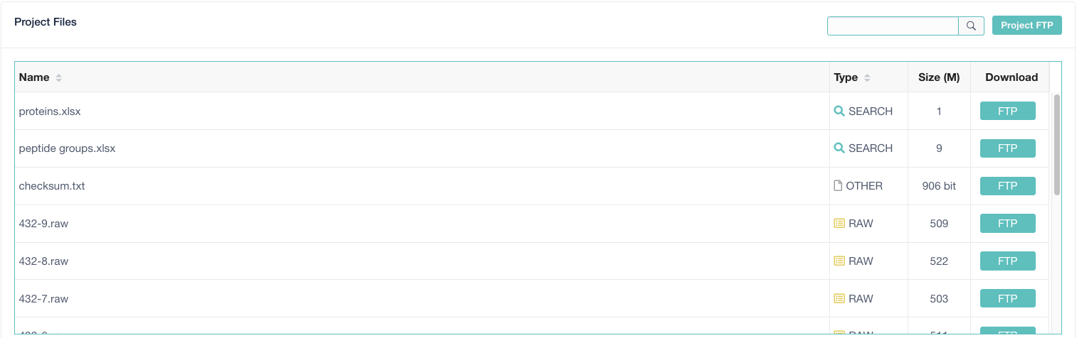
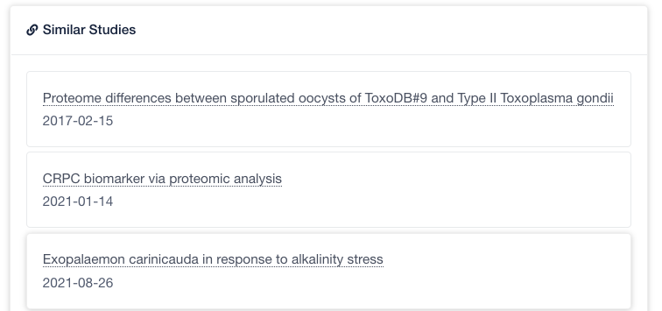
Dataset description

Slide 11
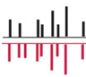
PRIDE Peptidome
mzid/mztab
Peak lists
PRIDE Archive Import
Mapping to Uniprot accessions
PX
Complete
.
.
n
sparkMS
Peptide + protein
grouping
PIA
QC
FDR Filtering for 1%.
Peptide length 8 AA
Number of projects by peptide+protein combination.
Remove peptide+protein combinations that can’t be map to uniport.
Peptides/Proteins
MongoDB
http://wwwdev.ebi.ac.uk/pride/peptidome
Yasset Perez-Riverol, et. al. Nucleic Acids Research, Volume 50, Issue D1, 7 January 2022, Pages D543–D552, https://doi.org/10.1093/nar/gkab1038

Slide 12
PRIDE Peptidome data
1294 Projects
217’261 Proteins
2’300’389 Peptides
1’922’855 Unique Peptides
150’658’201 PSMs

Slide 13
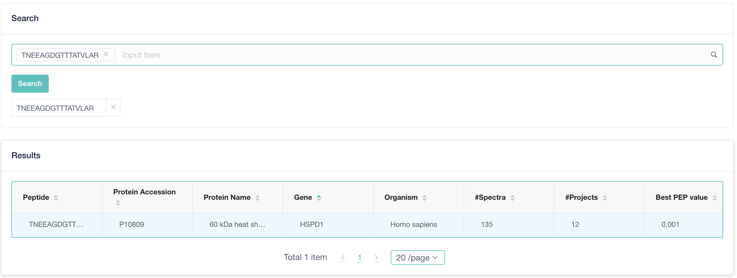
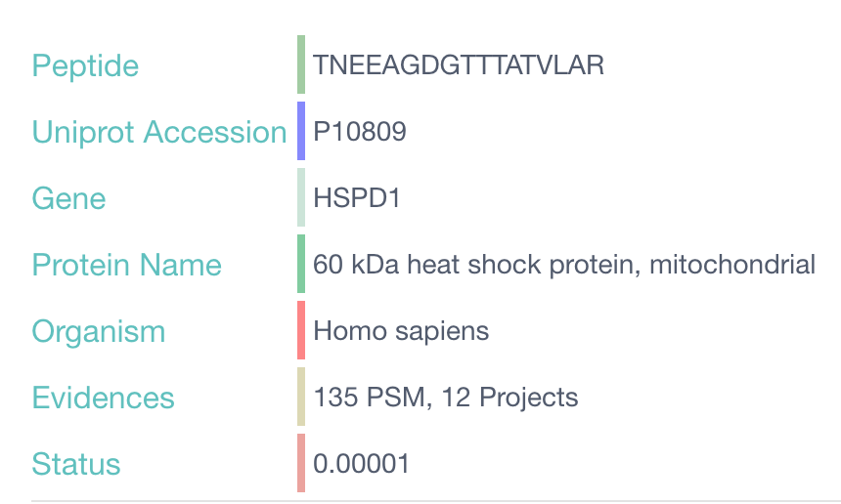
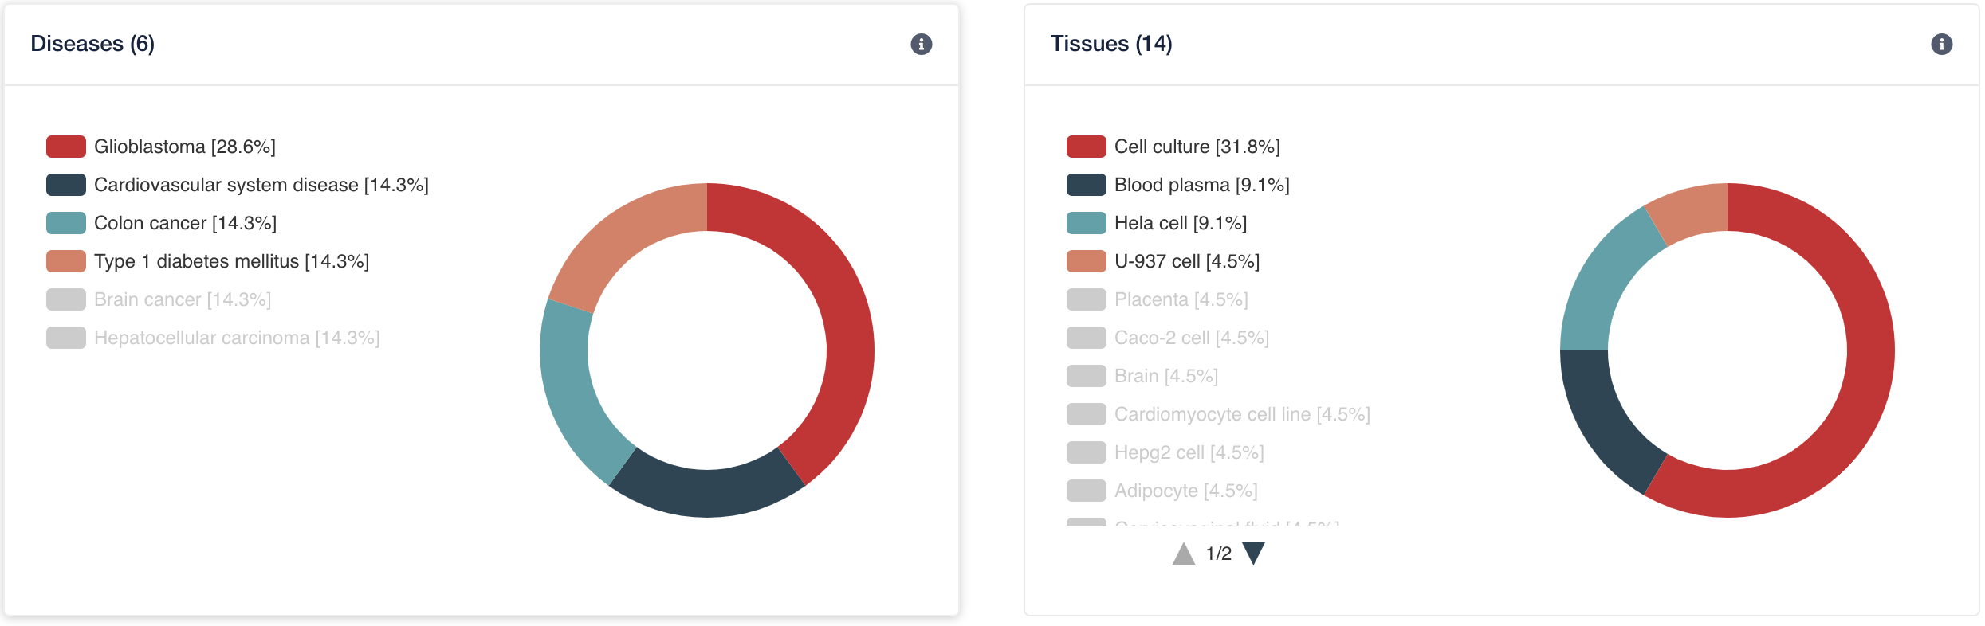
Peptidome viewer
Search by peptides, protein accessions, names, gene names.
Peptide + protein visualization including names, number of psms and projects.

Slide 14
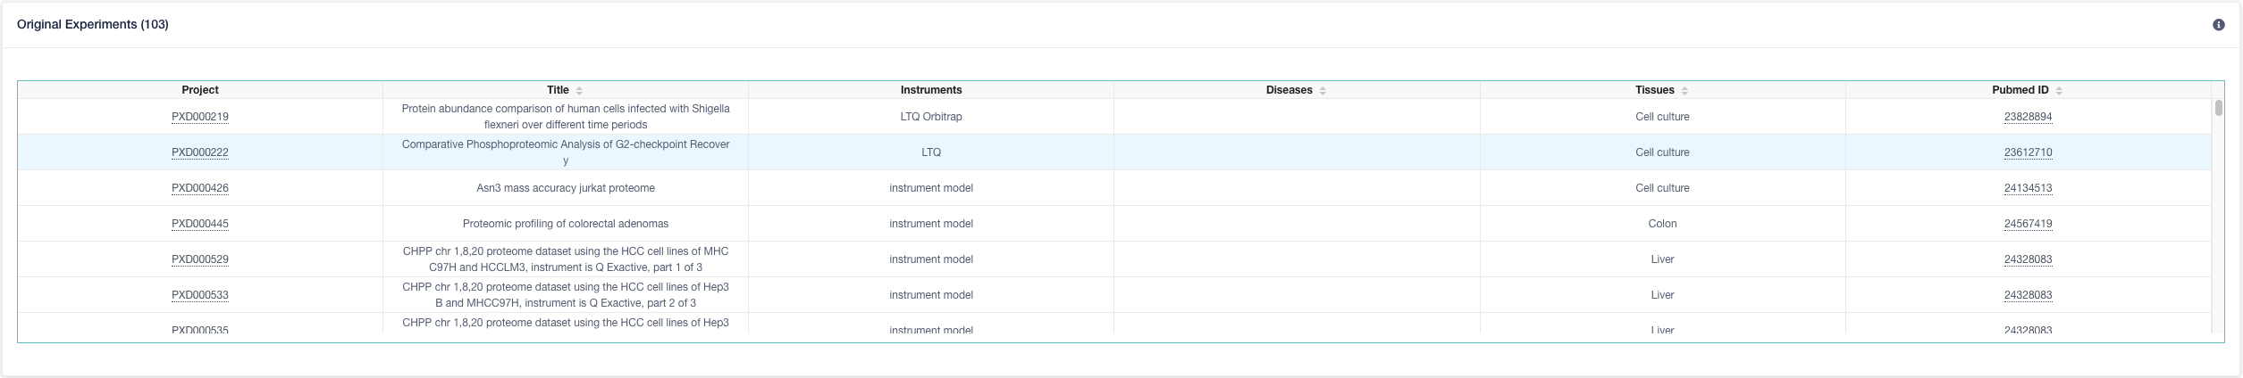
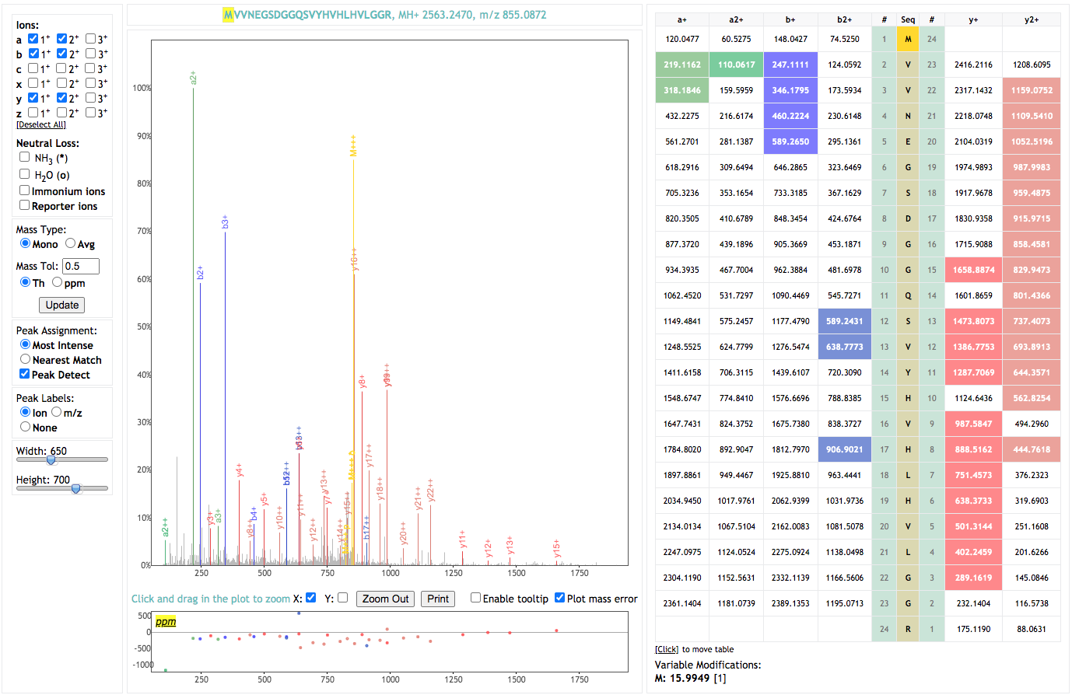
Peptidome viewer One spectrum (best scored)
Peptide Evidence: MVVNEGSDGGQSVYHVHLHVLGGR (P49773)

Slide 15
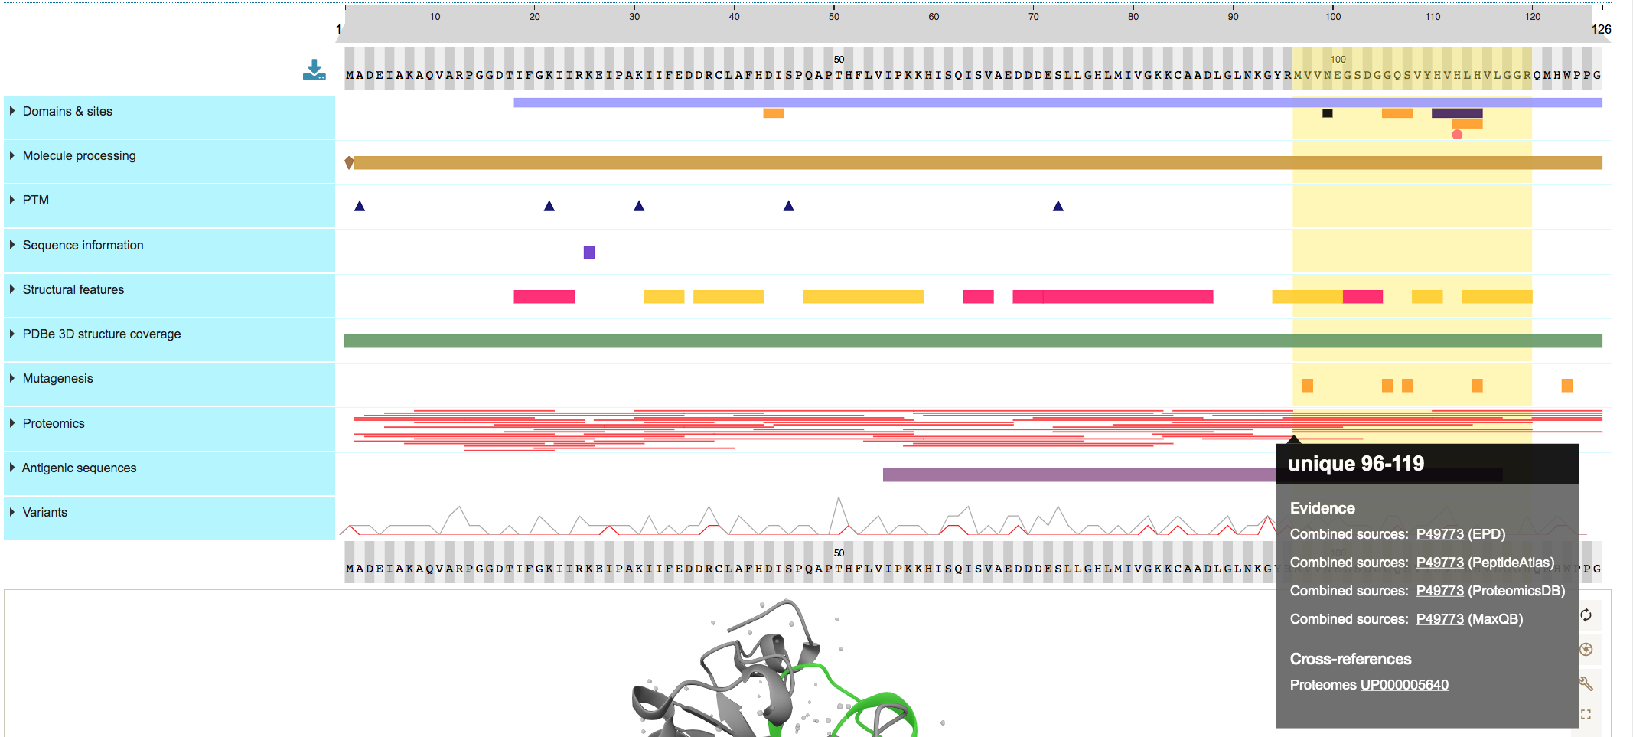
Uniprot Viewer
Peptide Evidence: MVVNEGSDGGQSVYHVHLHVLGGR (P49773)
Currently support for: PeptideAtlas, ProteomicsDB and MaxQB, PRIDE (Ongoing)

Slide 16
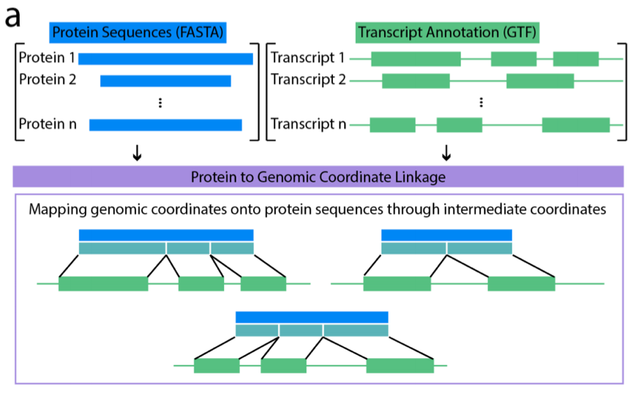
ENSEMBL integration
High-Quality
Peptides
PRIDE Peptidome
Peptide Export
Track
Peptide Tables
(Pogo File)
TrackHub Registry
Taxonomies
Taxonomies
https://github.com/bigbio/pepgenome/

Slide 17
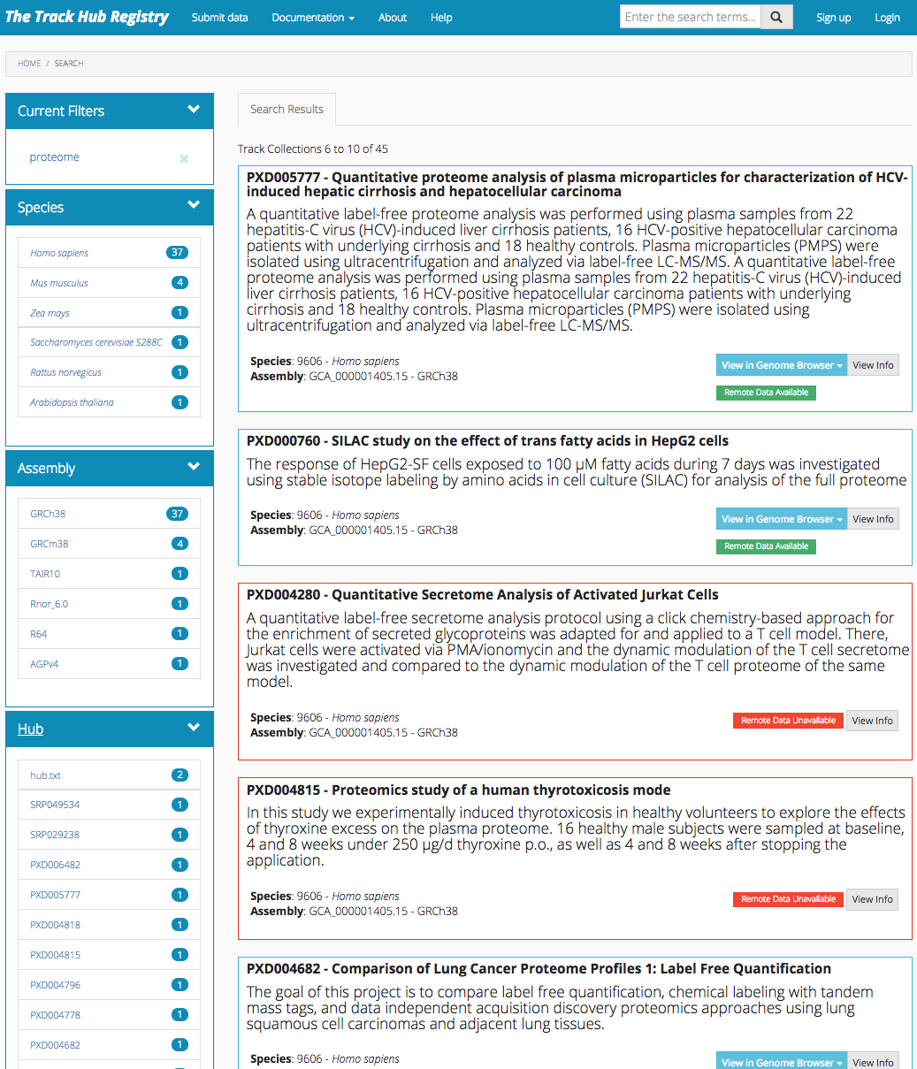
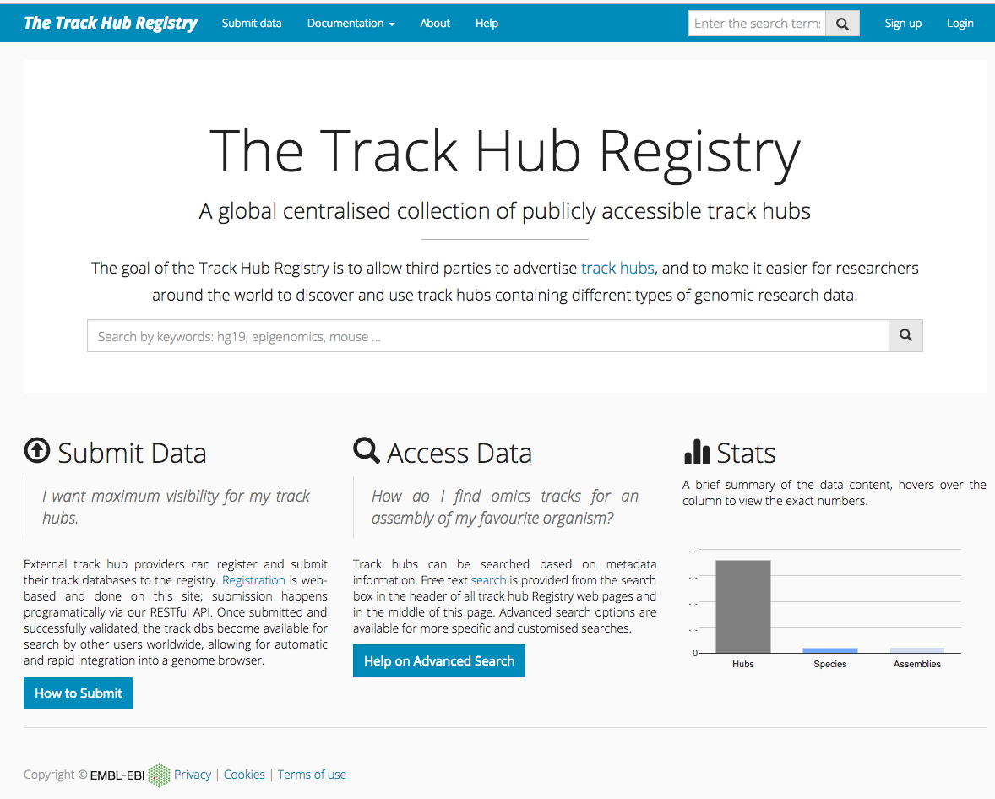
ENSEMBL Integration

Slide 18
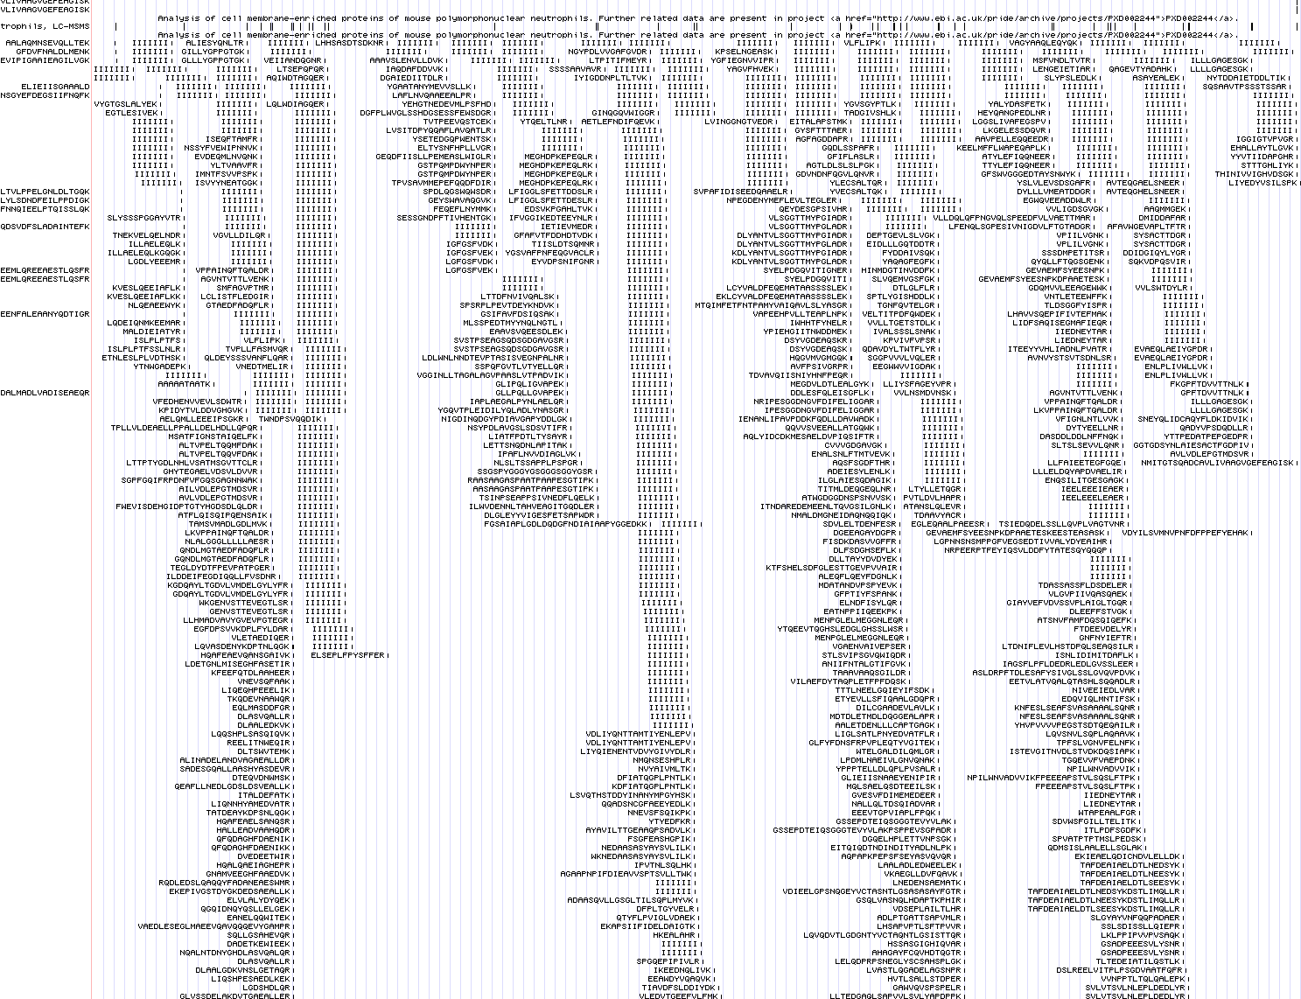
ENSEMBL Integration

Slide 19
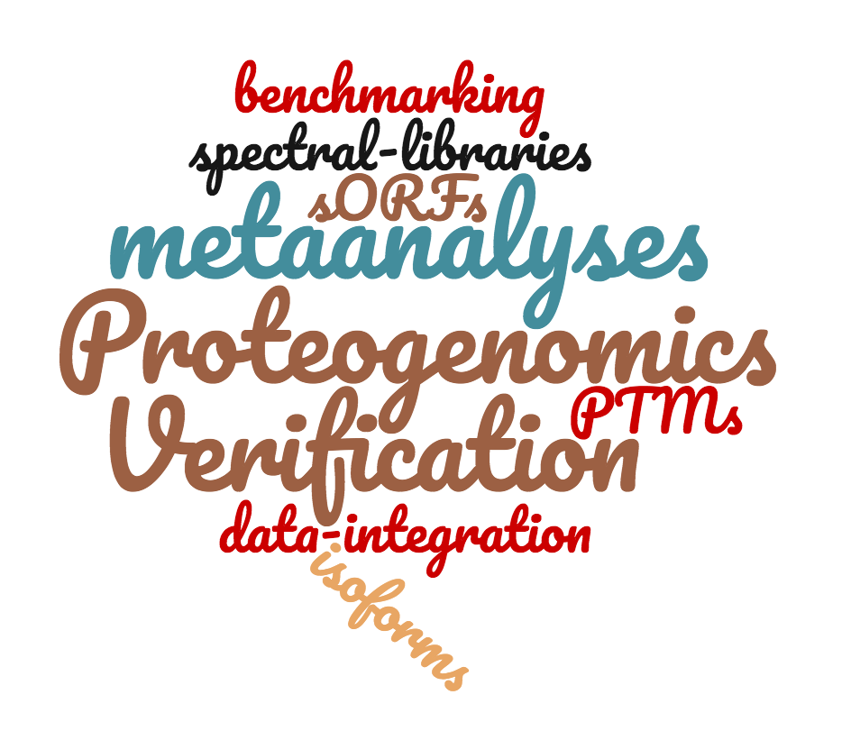
Public proteomics data is increasingly re-used
Downloads in TB

Slide 20
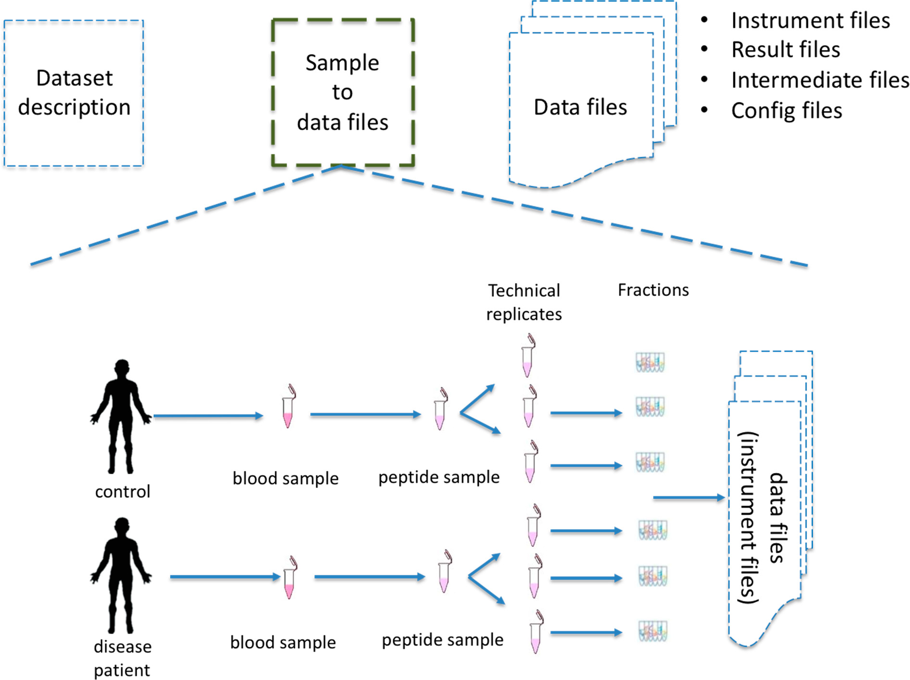
The Sample to Data Relationship Format (SDRF)
Sample metadata.
The data files metadata
The relation between the samples and data files, especially the instrument MS data. (Experimental Design)
Dai, C., Füllgrabe, A., Pfeuffer, J. et al. Nat Commun 12, 5854 (2021). https://doi.org/10.1038/s41467-021-26111-3

Slide 21
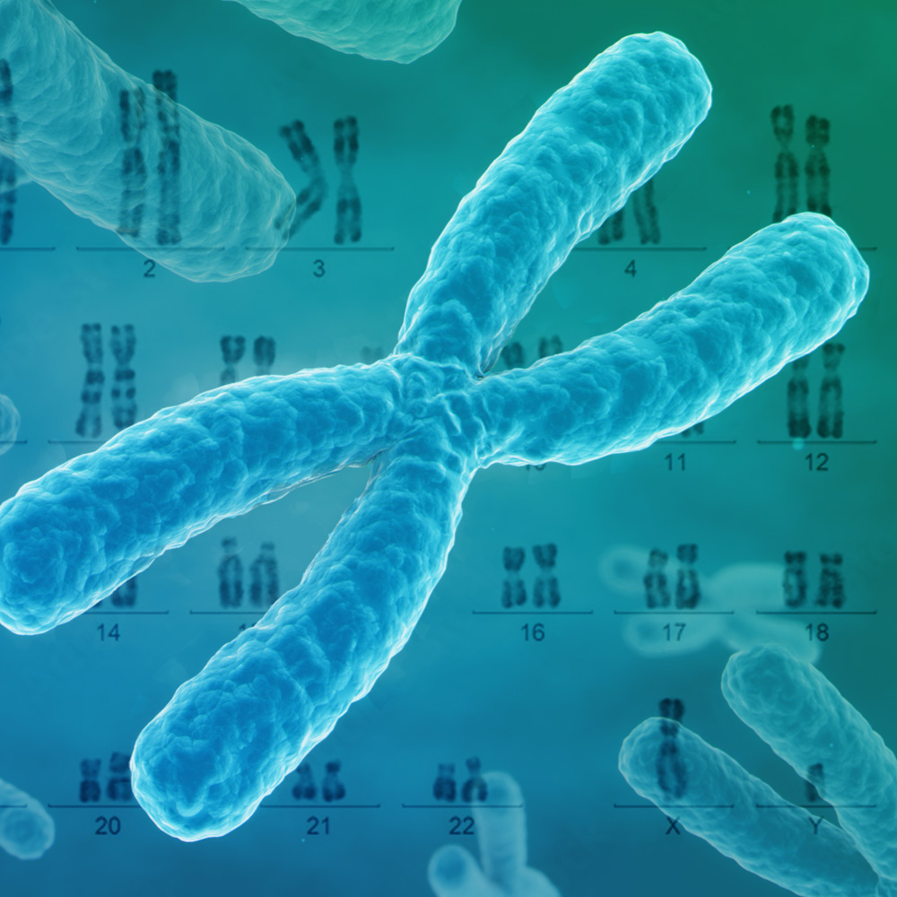
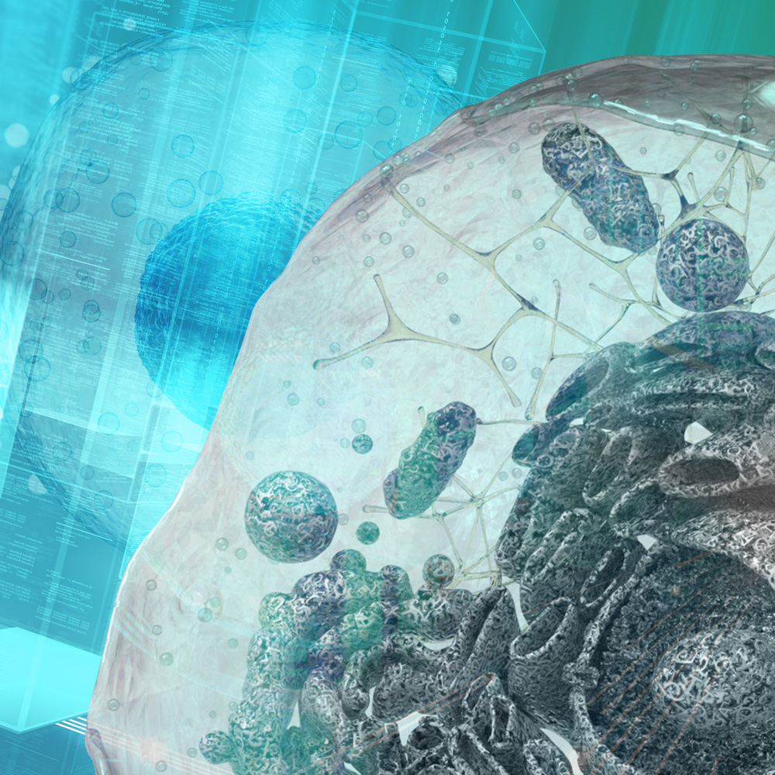


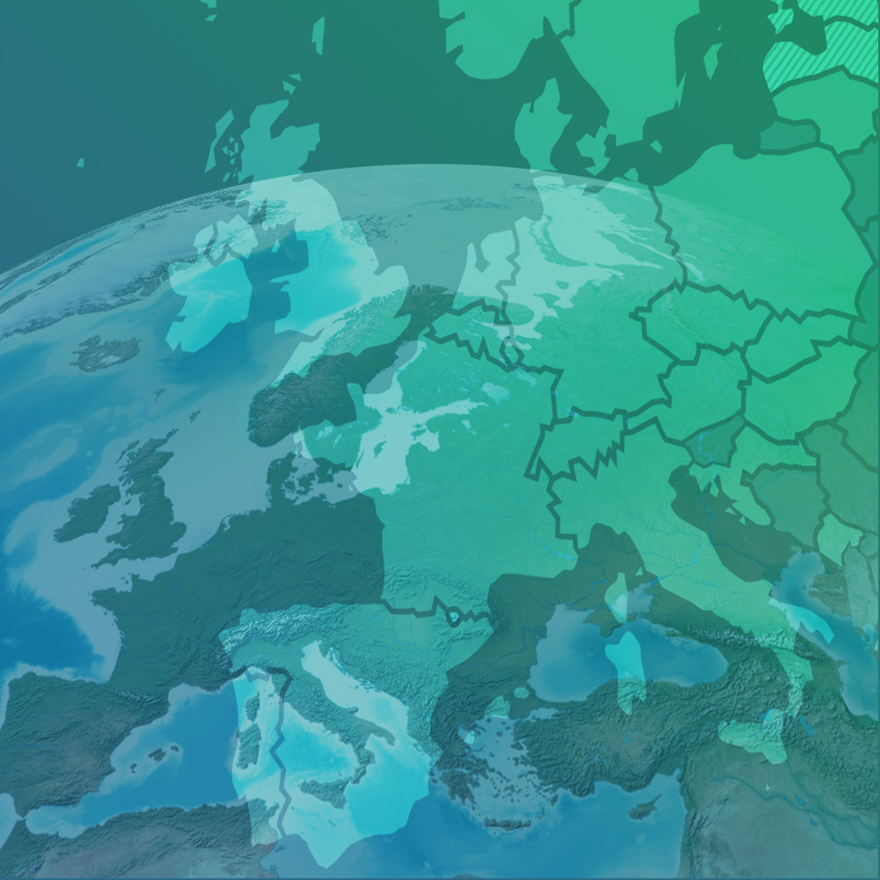
SDRF features
Simple for submitters
Ontology-based
Compatible with existing PSI formats
multiomics oriented
focus on data reuse
Notes:
Our missions are:
To freely provide data and bioinformatics services to the scientific community in ways that promote scientific progress.
To contribute to the advancement of biology through investigator driven research in bioinformatics.
To provide bioinformatics training to scientists at all levels.
To disseminate cutting-edge technologies to industry and applications of science.
To support, as an ELIXIR Node, the coordination of biomolecular data provision in Europe.

Slide 22
source name
Sample accession
factor value[phenotype]
necrotic tissue
normal
assay name
Data file accession
Label free experiment with no fractions
Run 1
Sample 1
Technical replicates
01.raw
Sample 1
necrotic tissue
biological replicate 1
Run 2
02.raw
Run 3
Sample 2
Technical replicates
03.raw
Sample 2
necrotic tissue
biological replicate 2
necrotic tissue
Run 4
04.raw
Run 5
Sample 3
Technical replicates
05.raw
Sample 3
normal tissue
biological replicate 1
Run 6
06.raw
Run 7
07.raw
Sample 4
Sample 4
Technical replicates
normal tissue
biological replicate 2
Run 8
08.raw
normal tissue
Sample properties
Data file properties
Study variables
source name | characteristics [organism] | … | characteristics [disease] | characteristic [phenotype] | characteristics [biological replicate] | assay name | comment [fraction identifier] | comment [label] | comment [technical replicate] | … | comment [data file] | factor value [phenotype]
Sample 1 | homo sapiens | … | liver cancer | necrotic tissue | 1 | Run 1 | 1 | AC=MS:1002038;NT=label free sample | 1 | … | 01.raw | necrotic tissue
Sample 1 | homo sapiens | … | liver cancer | necrotic tissue | 1 | Run 2 | 1 | AC=MS:1002038;NT=label free sample | 2 | … | 02.raw | necrotic tissue
Sample 2 | homo sapiens | … | liver cancer | necrotic tissue | 2 | Run 3 | 1 | AC=MS:1002038;NT=label free sample | 1 | … | 03.raw | necrotic tissue
Sample 2 | homo sapiens | … | liver cancer | necrotic tissue | 2 | Run 4 | 1 | AC=MS:1002038;NT=label free sample | 2 | … | 04.raw | necrotic tissue
Sample 3 | homo sapiens | … | liver cancer | normal | 1 | Run 5 | 1 | AC=MS:1002038;NT=label free sample | 1 | … | 05.raw | normal
Sample 3 | homo sapiens | … | liver cancer | normal | 1 | Run 6 | 1 | AC=MS:1002038;NT=label free sample | 2 | … | 06.raw | normal
Sample 4 | homo sapiens | … | liver cancer | normal | 2 | Run 7 | 1 | AC=MS:1002038;NT=label free sample | 1 | … | 07.Raw | normal
Sample 4 | homo sapiens | … | liver cancer | normal | 2 | Run 8 | 1 | AC=MS:1002038;NT=label free sample | 2 | … | 08.raw | normal

Slide 23
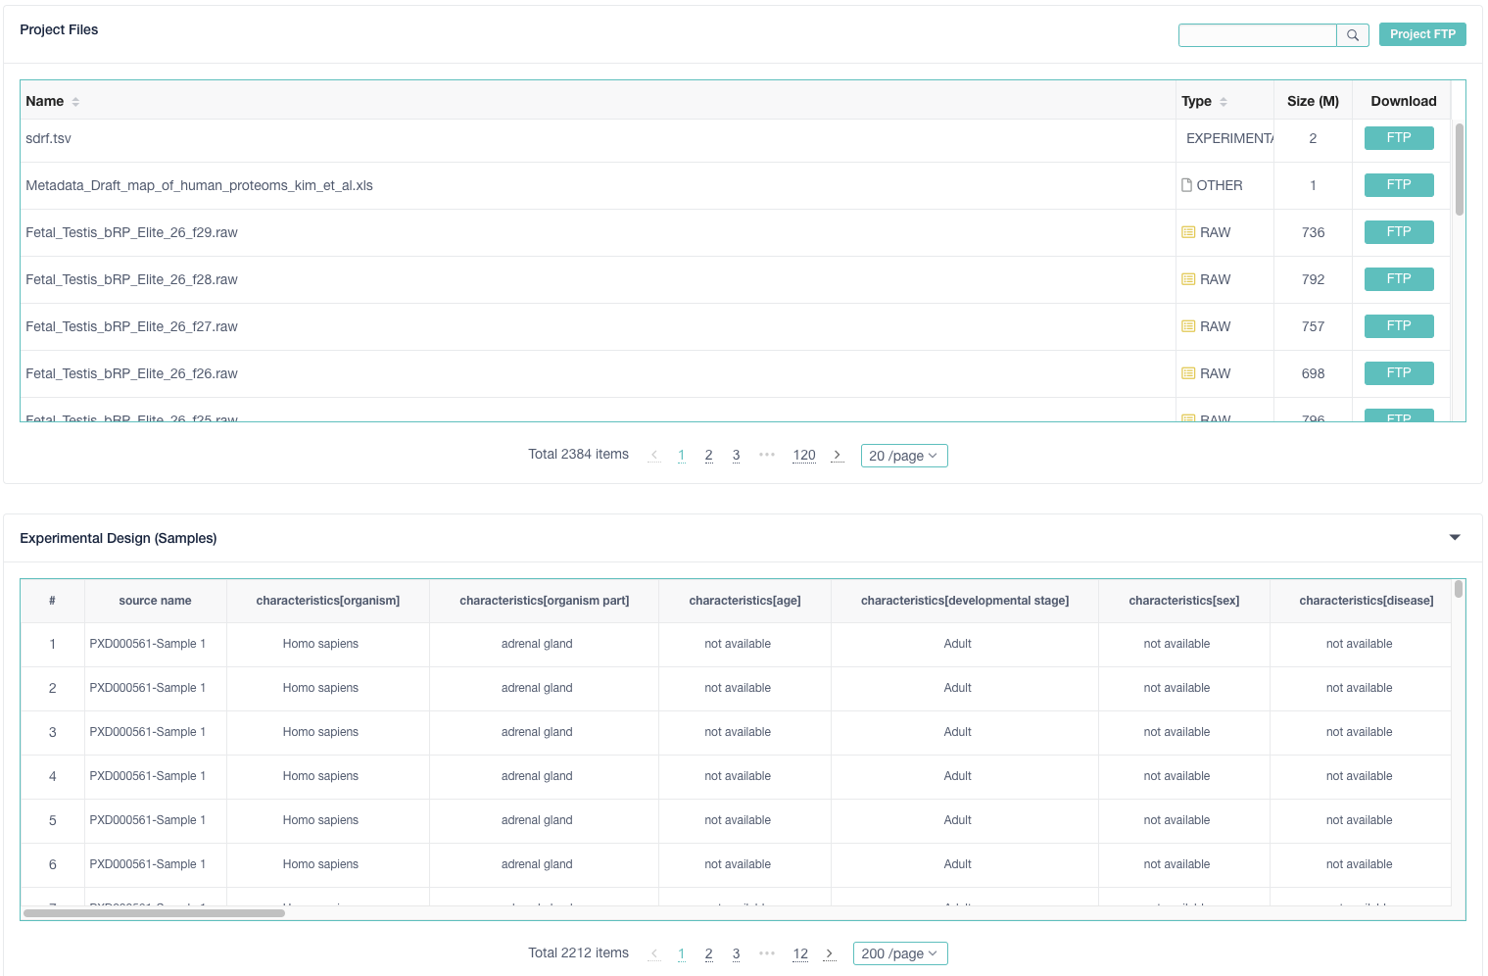


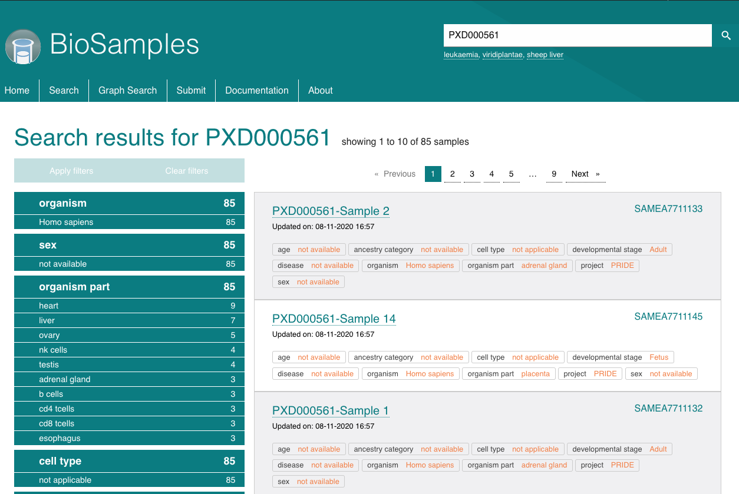
Validation
MAGE-TAB Proteomics
components
Conversion
configuration parameters
OpenMS
sdrf-pipelines (Python)
MaxQuant
SDRF
Proteomics
https://github.com/bigbio/sdrf-pipelines
MSstats
jSDRF (Java)
PRIDE Archive Web
IDF
https://github.com/bigbio/sdrf-pipelines
MAGE-TAB Proteomics
Bio-MAGETAB (Perl)
https://metacpan.org/release/Bio-MAGETAB
PRIDE Submission
Pipelines
PRIDE Submission Tool
BioSamples Web
RAWs
Results
Others
SDRF-Proteomics
jSDRF (Java)
{ BioSamples API }
https://www.ebi.ac.uk/biosamples/samples?text=PXD000561

Slide 24
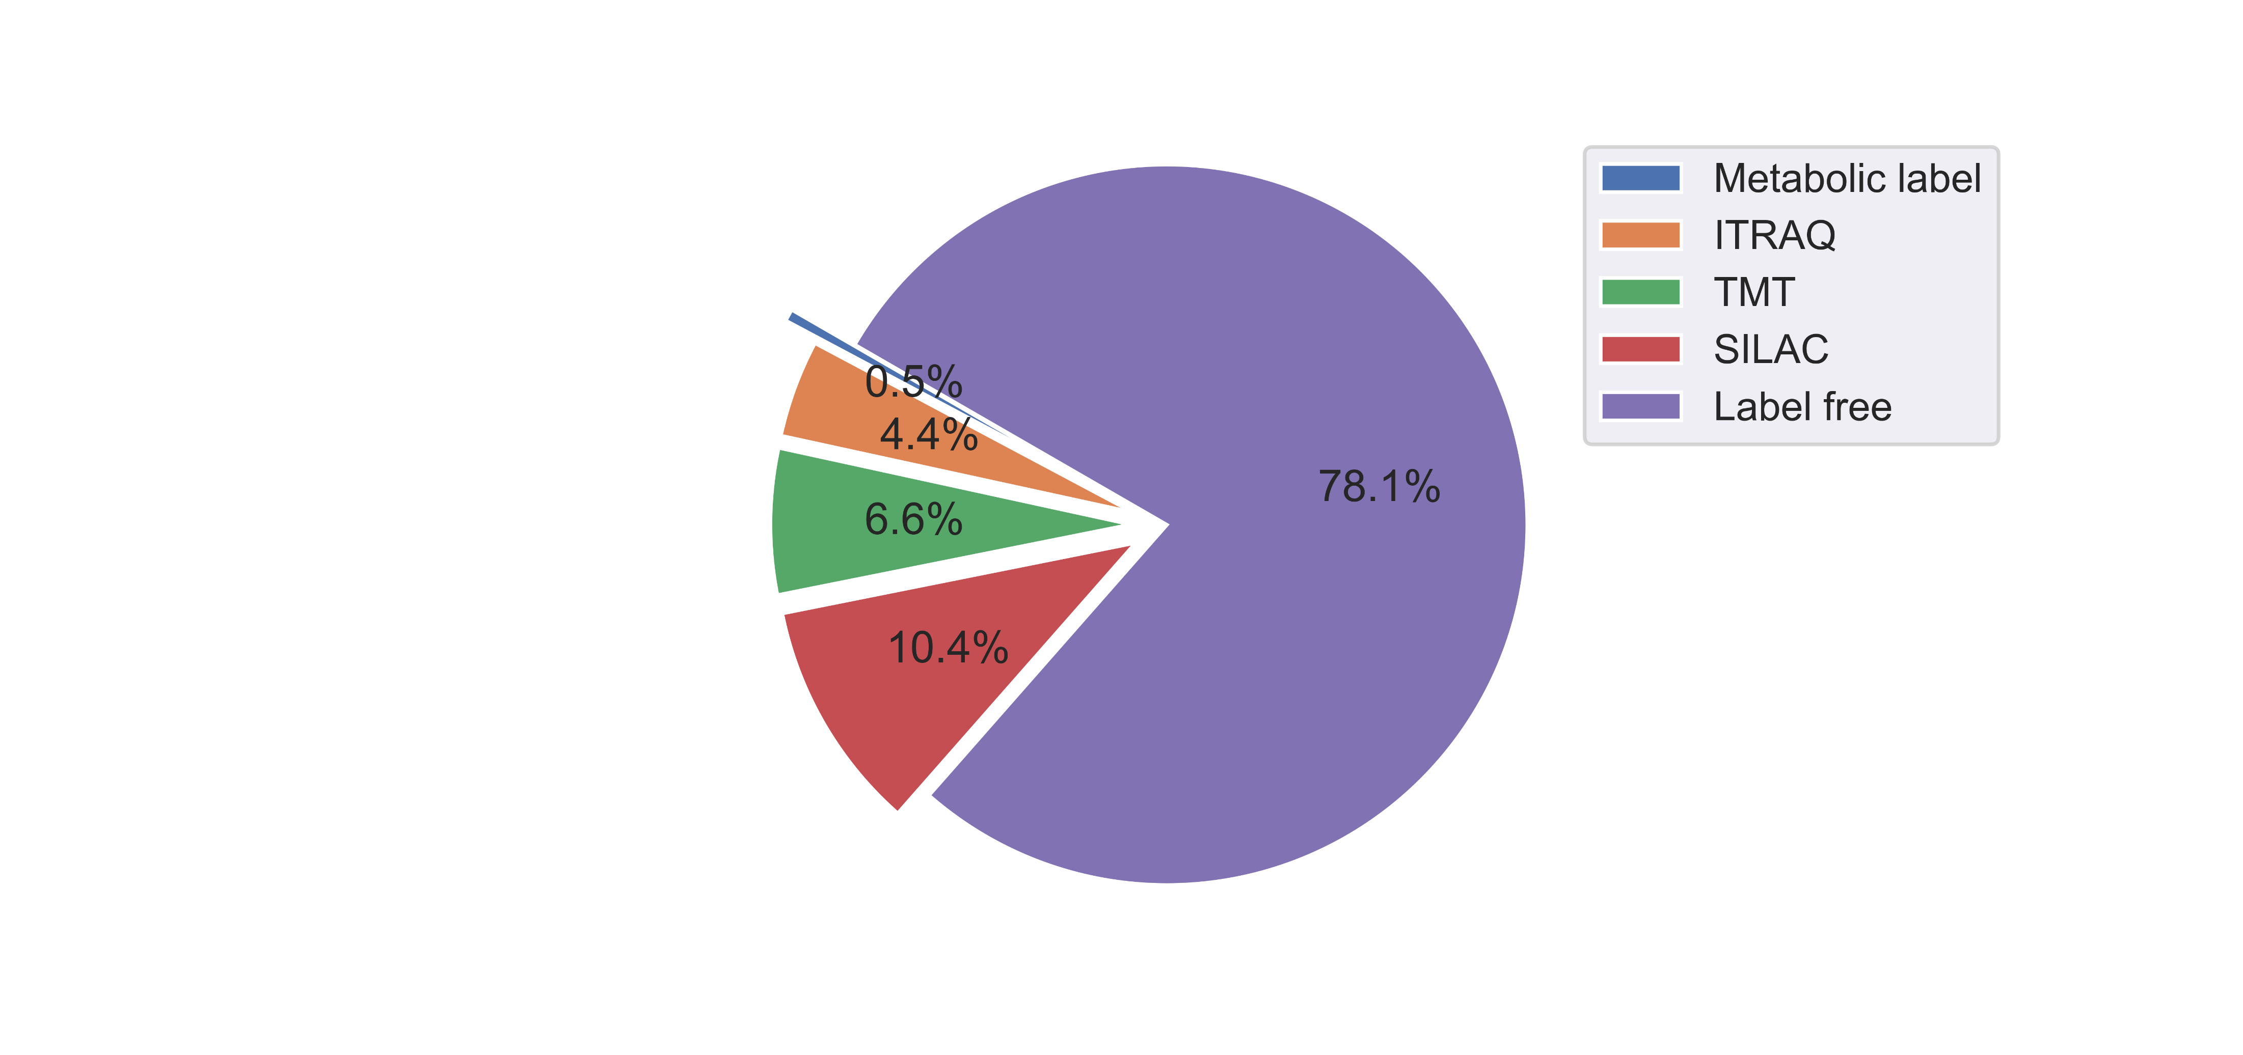
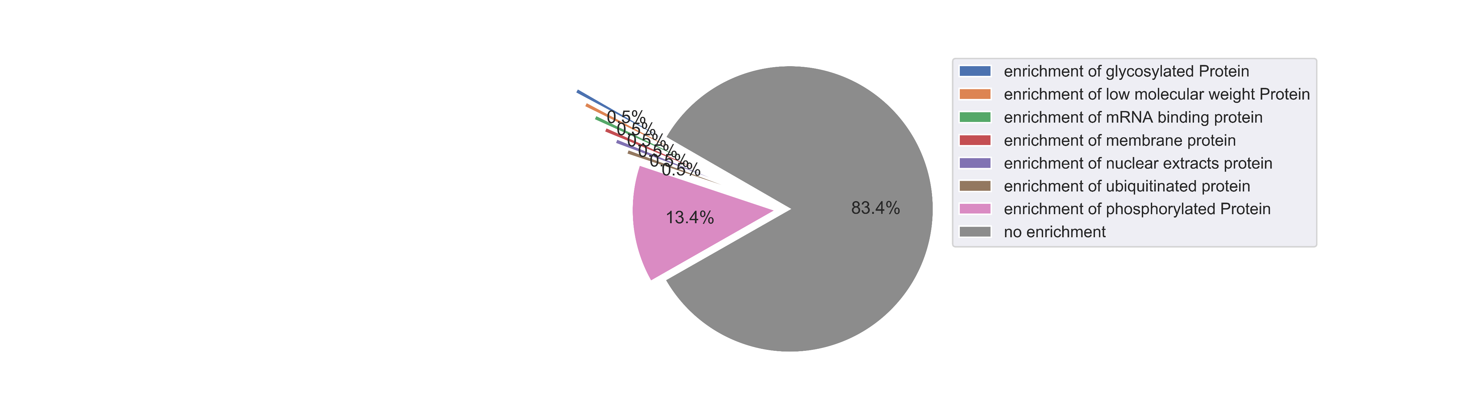
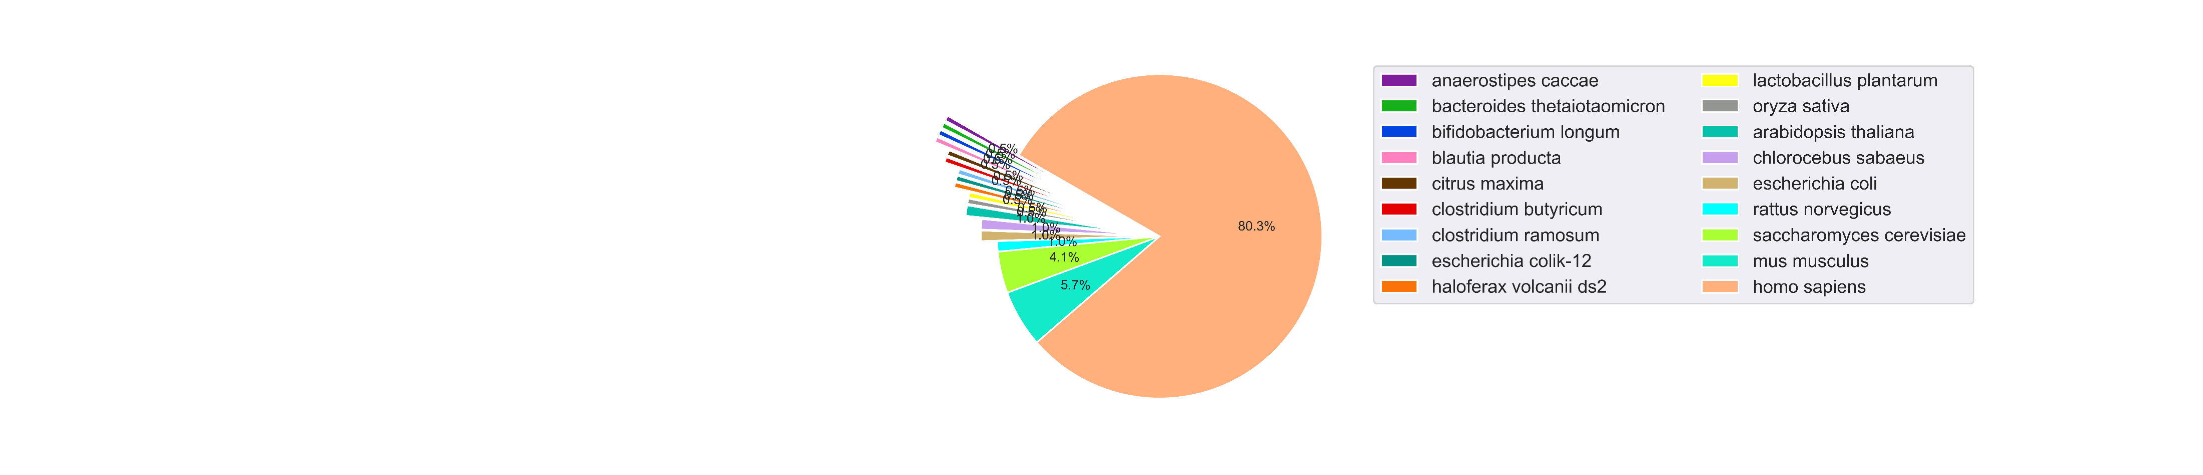
214 datasets annotated in proteomics-metadata
144 already included in PRIDE.

Slide 25
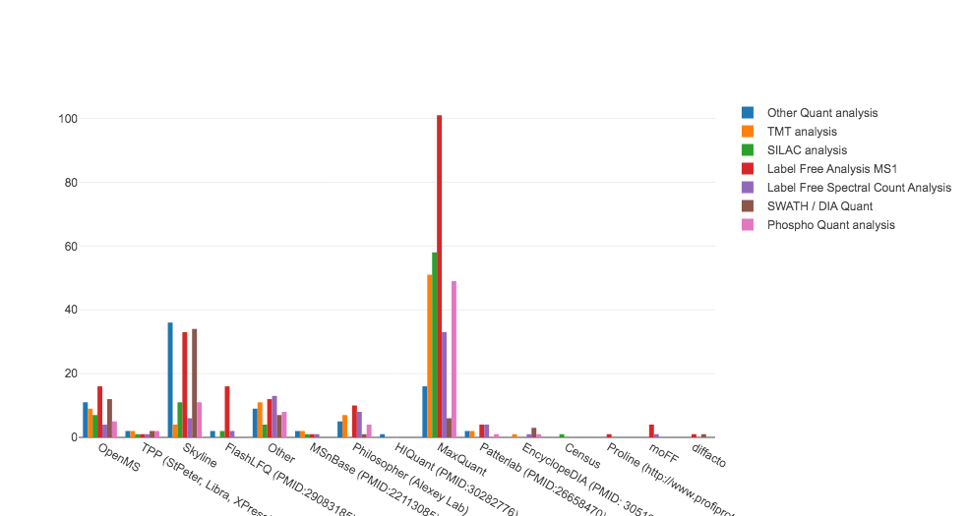
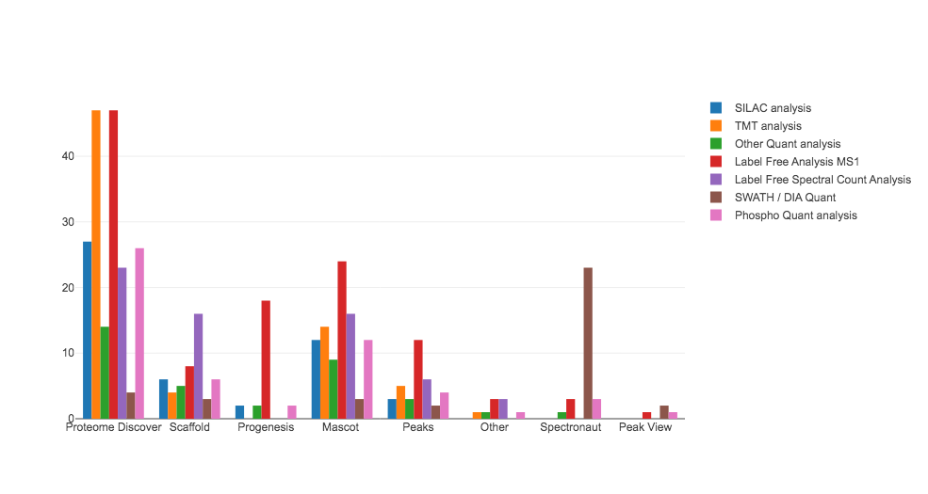
Quantification Tools Trends (2019/2022)
Usage
Free Quant Analysis Tools
Usage
Commercial Quant Analysis Tools
Citations
Free Quant and Identification Tools
Citations
“Best tool is the one that works for you.”

Slide 26

Reproducibility
Stream oriented
Unified parallelism
Reproducibility
proteomics
Feature Detection
DB creation
Candidate Proteins
Database Search
Applying FDR
Second Database Search
Applying FDR
Quant Peptides
Protein inference
Quant Proteins
Downstream analysis

Slide 27
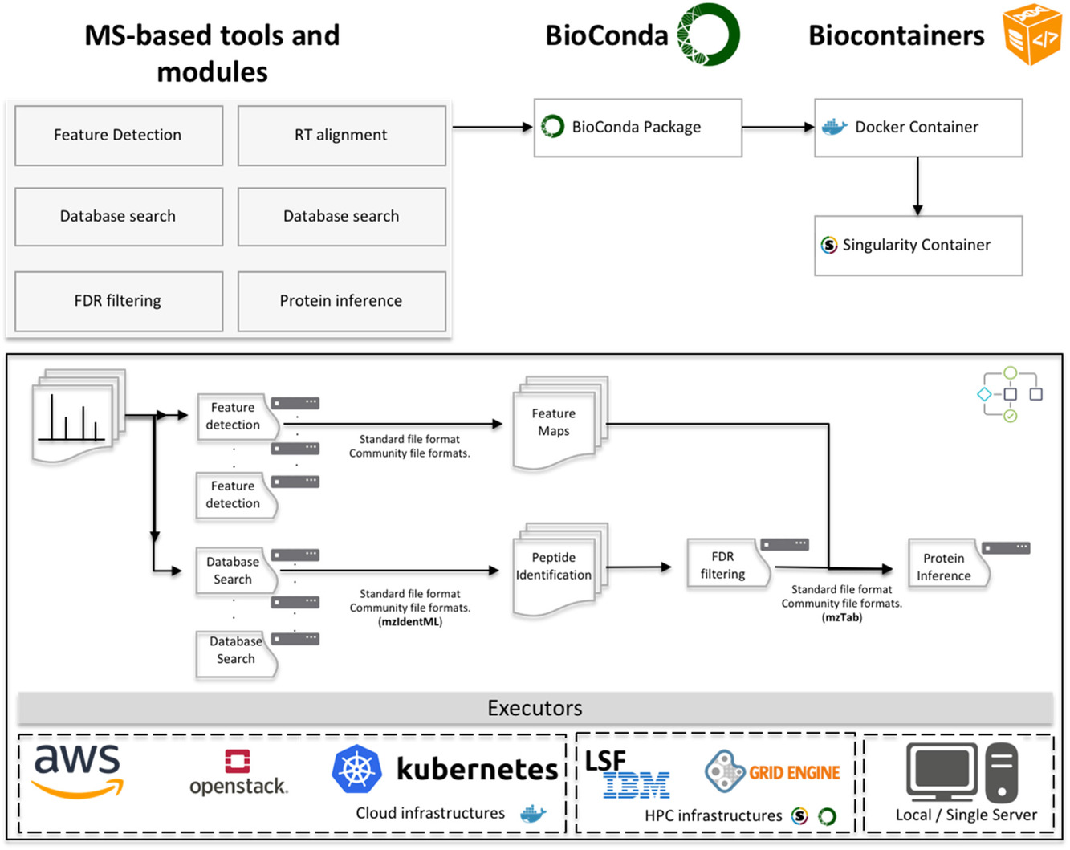
Cloud-based workflow
No installation needed.
All cloud and distributed architectures supported.
Small tasks (processing steps) are rung on independent nodes.
The same tools can be also run in Desktop computers.
Perez-Riverol Y, Moreno P. Proteomics. 2020 May;20(9):e1900147. doi: 10.1002/pmic.201900147. Epub 2019 Dec 18. PMID: 31657527.

Slide 28
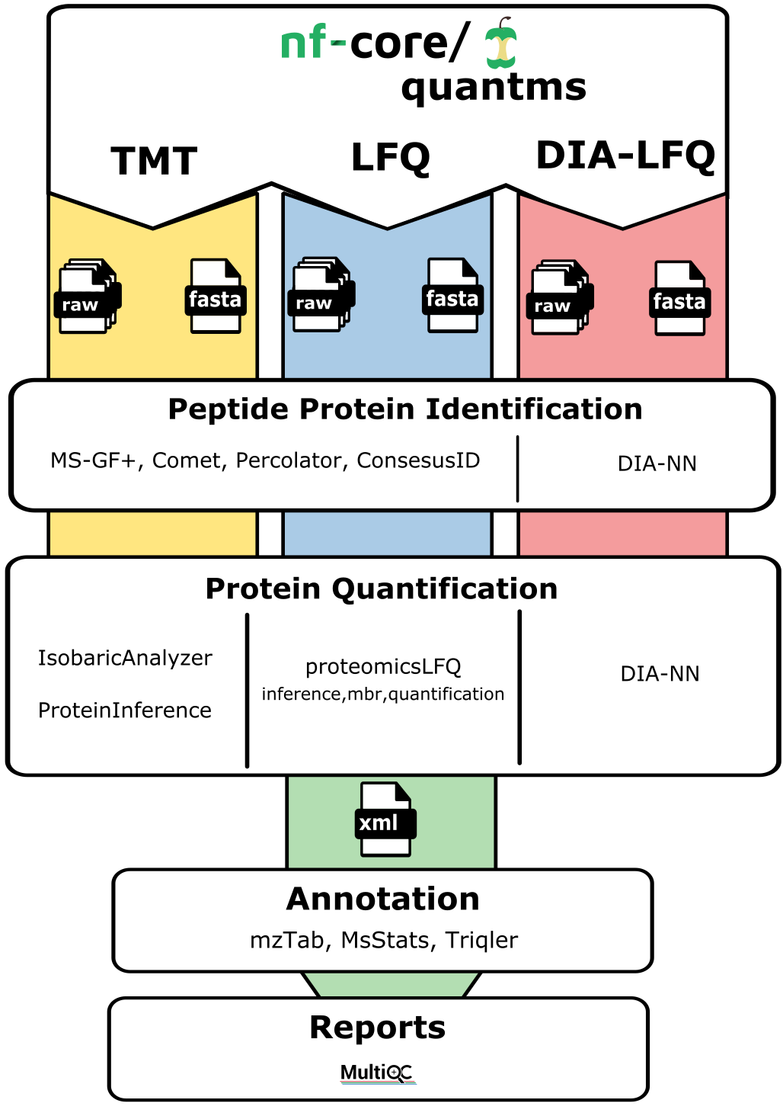
quantms: cloud-based to reanalyze proteomics data
DSL2 workflow under active development to perform LFQ/TMT and DIA data analysis.
Based on standard file formats (sdrf, mzML, mzTab)
Uses OpenMS tools and Opensource tools.
https://github.com/bigbio/quantms/

Slide 29
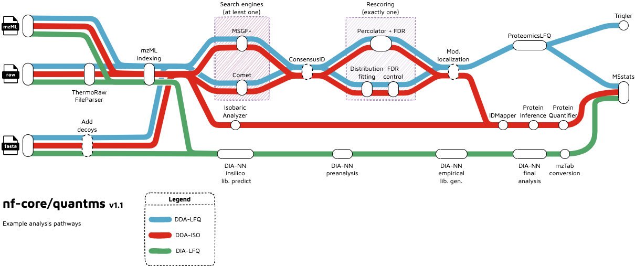
quantms: cloud-based to reanalyze proteomics data

Slide 30
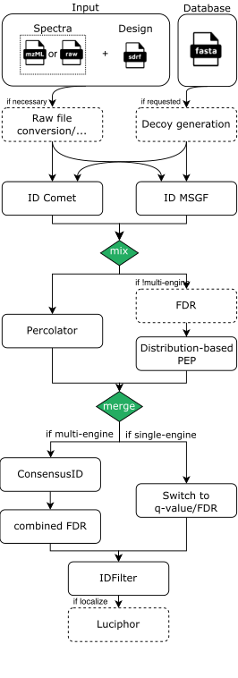
A common peptide/protein identification TMT/LFQ
Use multiple peptide identification tools Comet and MSGF+.
Use Percolator (SVM-based) to boost peptide identifications.
Apply multiple FDR-methods at peptide/protein identification level.
Phospho localization analysis using Luciphor.

Slide 31
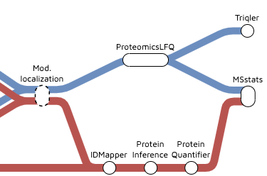
Quantification
In the proteininference step peptides and proteins from all samples are aggregated into a final protein list.
Final peptide and protein FDR threshold are applied at this steps.
Final outputs of the pipeline export the protein quantification values into mzTab, Triqler and Msstats

Slide 32
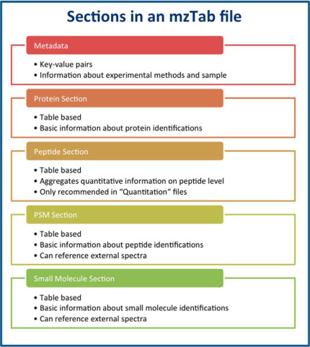
quantms: cloud-based to reanalyze proteomics data
Input:
SDRF proteomics: Tab-delimited file that contains sample metadata, experimental design and data analysis settings.
mzML: XML-baed Mass spectra standard file formant.
Output:
mzTab: Tab-delimited file containing peptides/ peptide-spectrum matches and protein identifications and quantification values.
Additional tab-delimited files for popular downstream analysis tools including Triqler, Msstats.

Slide 33
running nextflow
> curl -s https://get.nextflow.io | bash
> nextflow run main.nf -c nextflow.config -profile ebicluster --root_folder PXD000279/ --input PXD000279.sdrf.tsv --database uniprot-proteome_UP000005640_UP000000625.fasta --add_decoys true --search_engines msgf,comet --psm_pep_fdr_cutoff 0.01 --protein_level_fdr_cutoff 0.01 -resume
docker {
docker.enabled = true
docker.userEmulation = true
singularity.enabled = false
podman.enabled = false
shifter.enabled = false
charliecloud.enabled = false
}
ebicluster{
params.enable_conda = true
docker.enabled = false
singularity.enabled = false
conda.createTimeout = '1 h'
conda.useMamba = true
process.executor = 'lsf'
}
https://www.nextflow.io/docs/latest/getstarted.html

Slide 34
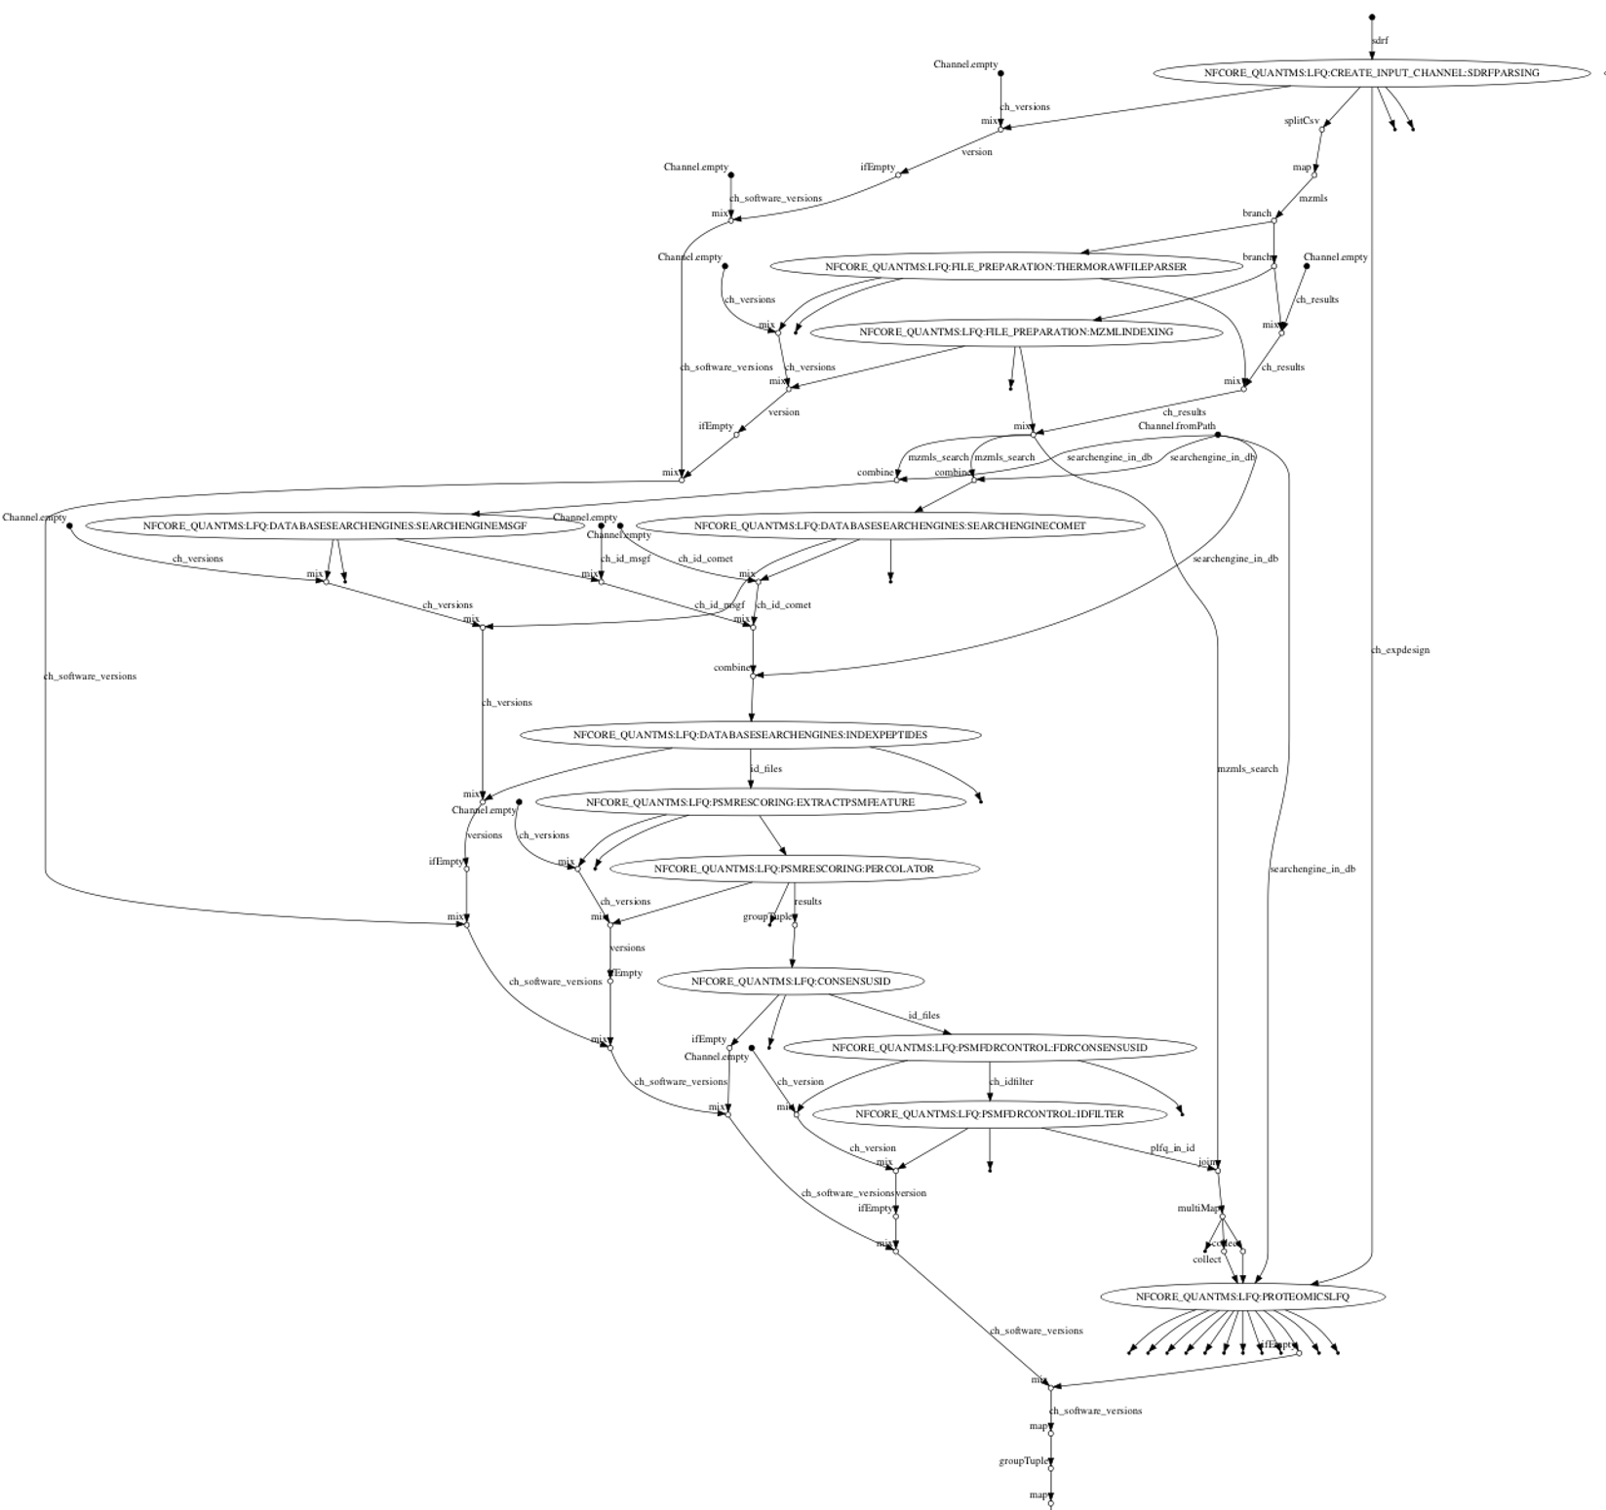
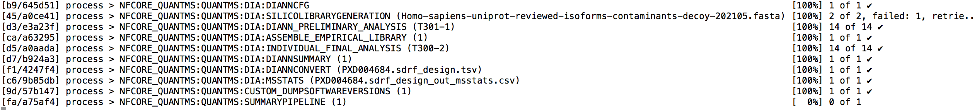
Steps granularity
All steps can be automatically re-launch depending on the errors that occurs.
All workflows and Tools and divided into multiple steps to increase scalability and distribution.
Aggregation steps are needed to compute in single node to perform statistical tasks

Slide 35
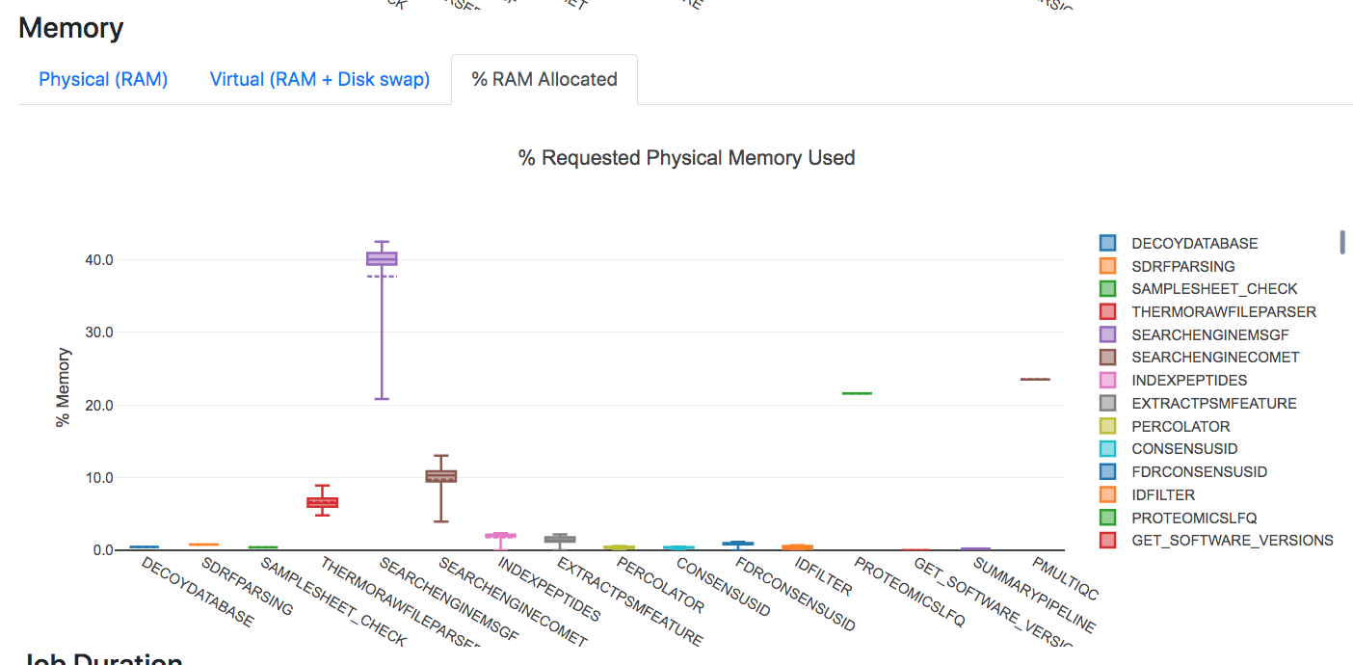
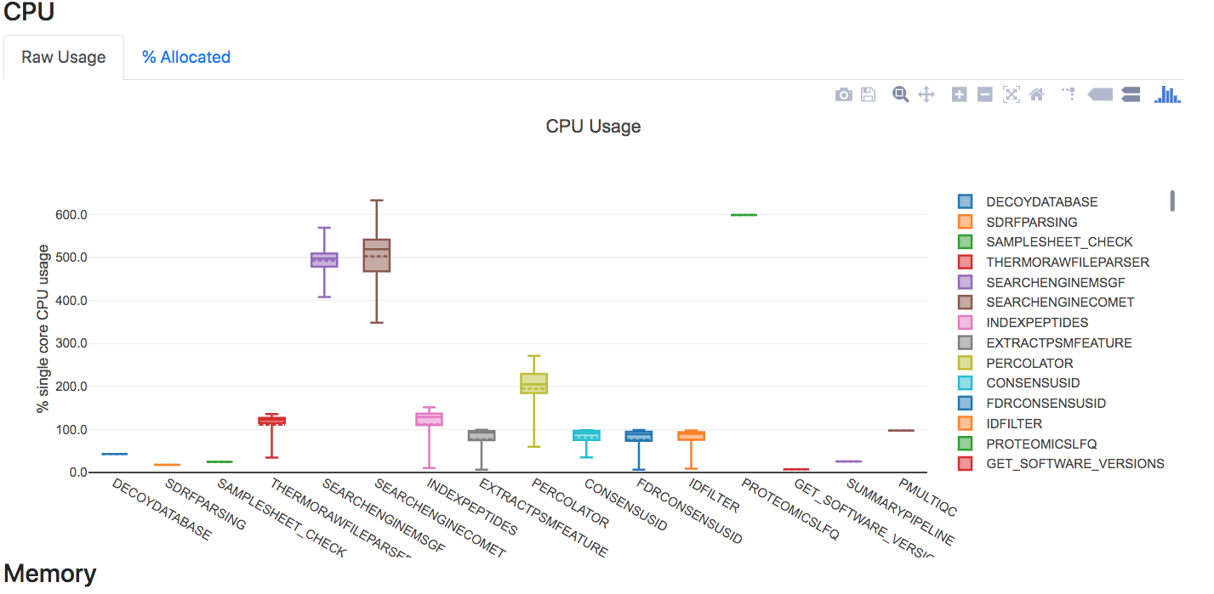
Reporting the workflow resources.
https://tinyurl.com/vm8tthes

Slide 36
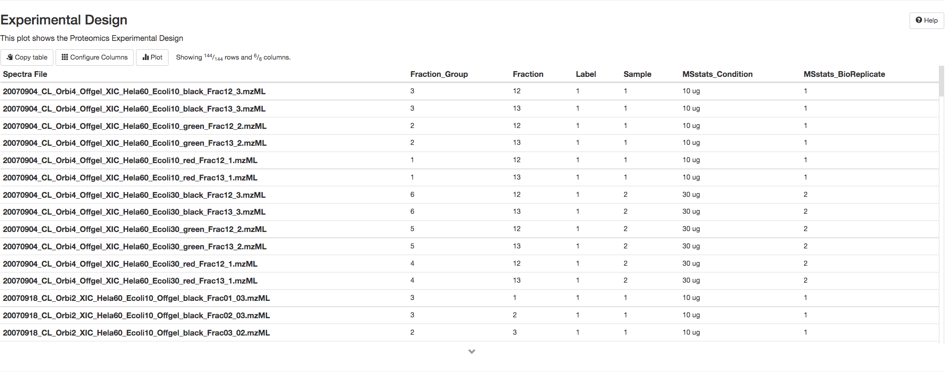
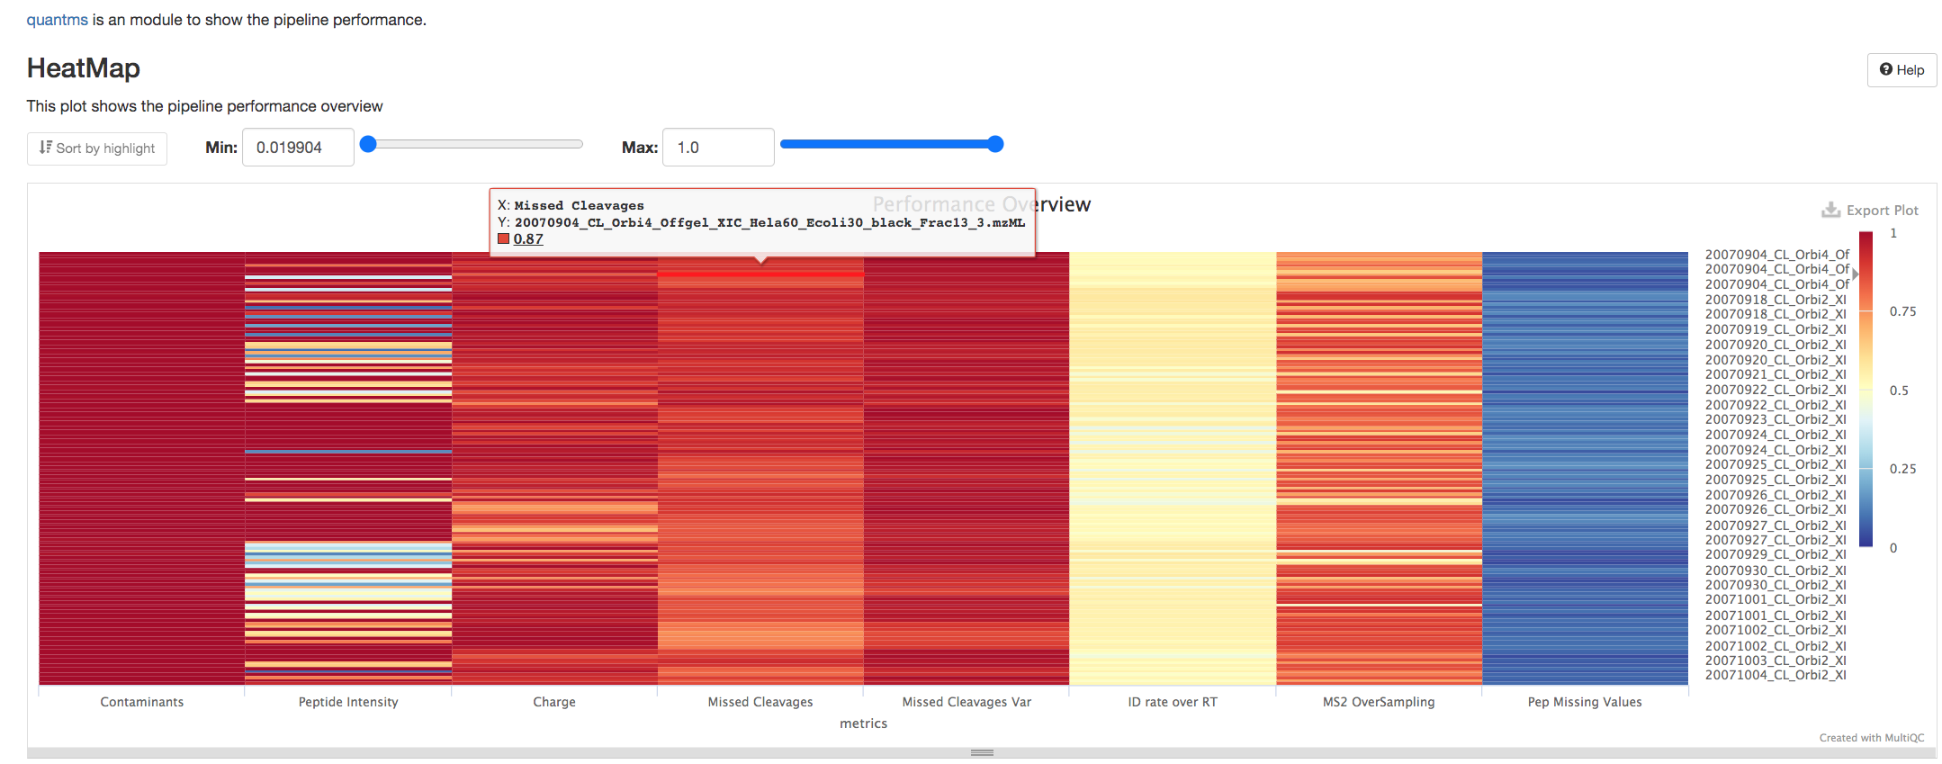
QC reports with pmultiqc
Experimental design in Msstats
Quality Control over all the MS runs:
Intensity
Charge
Rt
Miss-cleavages
https://tinyurl.com/2p85txhc

Slide 37
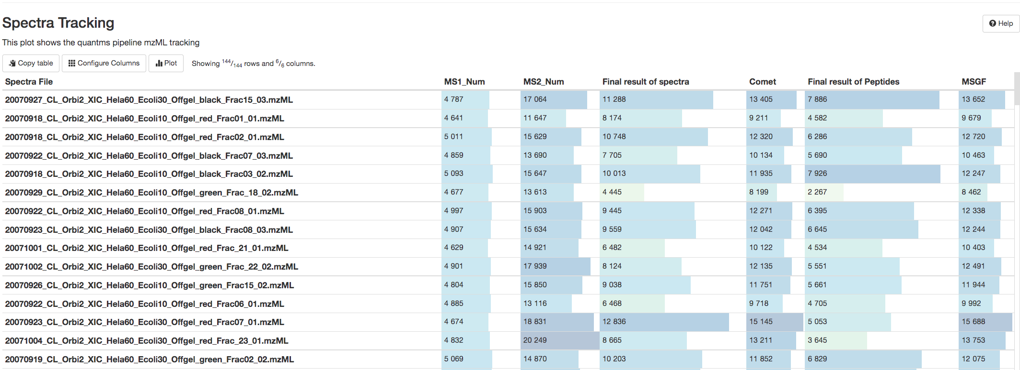
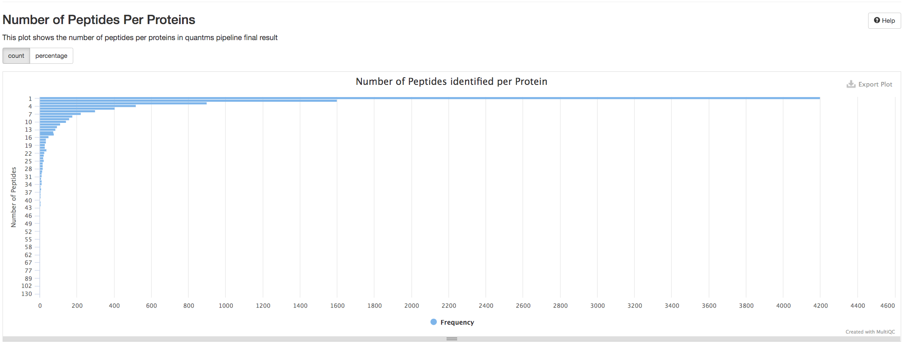
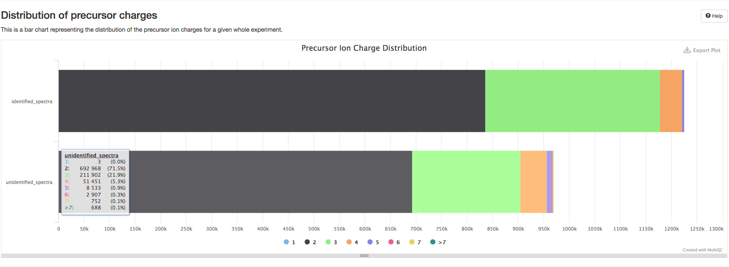
QC reports with pmultiqc
https://tinyurl.com/2p85txhc

Slide 38
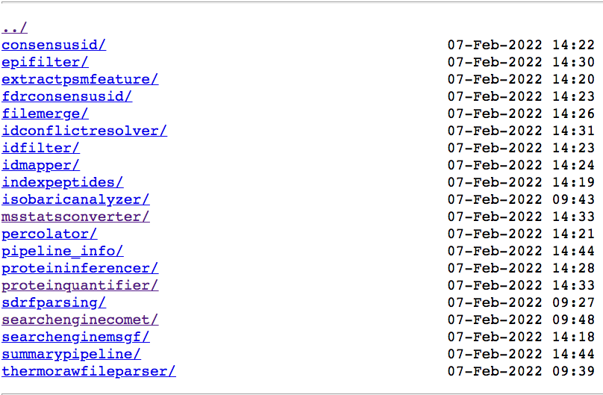

Results of quantms
Results, intermediate steps and information execution of the pipeline are stored in multiple folders.

Slide 39

Proteogenomic reanalysis of public data
Non-canonical Proteins
Alternative reading frames
Pseudogenes
Non-coding RNAs
ENSEMBL
No redundancy between Target and Decoy peptides
Genomic Variants (VCF)
Gene Annotations (GTF)
Transcript
Processor
Reference Sequences (FASTA)
Decoy Generator
Canonical Proteins
Final protein database
(Target + Decoy)
Genomic Variants
COSMIC & COSMIC-CLP
Variant
Processor
gnomAD
cBioPortal
Patient specific data
Genomic Variants (VCF)

Slide 40


Reanalysis of public proteomics data
Reanalyzed data
6 PRIDE datasets
65 cancer cell lines
20M
MS/MS
6M
PSMs
5M
Canonical
315’085
Non-Canonical
2’883
Mutant
21’148
Variant

Slide 41

ENSEMBL Visualization

Slide 42

Bulk Expression Atlas
Available for ~10 years now
>4k studies
65 species including Human, Mouse, Rat, Worm, Fruitfly
Differential and baseline expression
Microarrays, RNA-Seq
83 Proteomics
>150k assays analyzed
Standardized analysis workflows
Ontology annotated curated metadata
https://www.ebi.ac.uk/gxa
Notes:
The EBI Single Cell Expression Atlas is an added value resource for single cell RNA-seq experiments. It is available since June 2018, hosting 184 studies across 14 species, including Human, Mouse, Rat, Worm, and Fruitfly among others. It hosts Human Cell Atlas preview datasets. It has re-analyzed more than 3 million cells with standardized data analysis pipelines. All its metadata is manually curated and annotated with ontologies. You might have heard more details from my colleague Dr. Suhaib Mohammed in the previous talk, if you haven’t I presume that you can access that recording later if you want to know more.
We had to work hard on specific challenges to make this possible…
(27'')

Slide 43

Protein Expression Atlas
Notes:
The EBI Single Cell Expression Atlas is an added value resource for single cell RNA-seq experiments. It is available since June 2018, hosting 184 studies across 14 species, including Human, Mouse, Rat, Worm, and Fruitfly among others. It hosts Human Cell Atlas preview datasets. It has re-analyzed more than 3 million cells with standardized data analysis pipelines. All its metadata is manually curated and annotated with ontologies. You might have heard more details from my colleague Dr. Suhaib Mohammed in the previous talk, if you haven’t I presume that you can access that recording later if you want to know more.
We had to work hard on specific challenges to make this possible…
(27'')

Slide 44


Example results
Partial bulk baseline result of searching for SCD,
a Parkinson’s target, at different developmental stages and tissues
304 studies
20 species including Human, Mouse, Rat, Worm, Fruitfly
>8.5M cells analyzed

Slide 45










Acknowledgements
OpenMS Team:
Julianus Pfeuffer, Timo Sachsenberg
Chongqing Key Laboratory of Big Data
for Bio Intelligence
Chengxin Dai, Hong Wang, Jingwen Deng,
Mingze Bai
Vadim Lab
Vadim Demichev
PRIDE Team
Yasset Perez-Riverol

